Slide 1
Privacy-Preserving Query Execution using a Decentralized Architecture and Tamper Resistant Hardware
Quoc-Cuong TO
SMIS project (INRIA, PRiSM-CNRS, UVSQ)
Supervisor: Philippe PUCHERAL Benjamin NGUYEN
Junior Seminar
INRIA May 20th 2014

Slide 2
SMIS: Secured and Mobile Information Systems
INRIA Paris-Rocquencourt
Joint team with CNRS & University of Versailles (UVSQ)

Slide 3
Background and research fields
A Core Database Culture …
Storage and indexing models, query execution and optimization
Transaction protocols (atomicity, isolation, durability)
Database security (access and usage control, encryption)
Distributed DB architectures
Notes:
Vient dans section 2.1 et 2.2 de la fiche de synthèse

Slide 4
Current composition of the team
Permanent members
Nicolas Anciaux CR INRIA
Luc Bouganim, DR INRIA
Benjamin Nguyen, MC UVSQ, since 2010
Philippe Pucheral, PR UVSQ
Iulian Sandu Popa, MC UVSQ, since 2012
PhD students
Saliha Lallali: Document Indexing for Embedded Personal Databases
Athanasia Katsouraki: Access and Usage Control for Personal Data in Trusted Cells
Cuong To: Secure Global Computations on Personal Data Servers
…

Slide 5
Privacy-Preserving Query Execution using a Decentralized Architecture and Tamper Resistant Hardware
Quoc-Cuong TO
SMIS project (INRIA, PRiSM-CNRS, UVSQ)
Supervisor: Philippe PUCHERAL Benjamin NGUYEN
Junior Seminar
INRIA May 20th 2014
Notes:
My presentation today introduces the way to execute the distributed query over the secure hardware.

Slide 6
Outline
Introduction
Asymmetric architecture
Generic protocol & variations
Information exposure analysis
Experiment

Slide 7
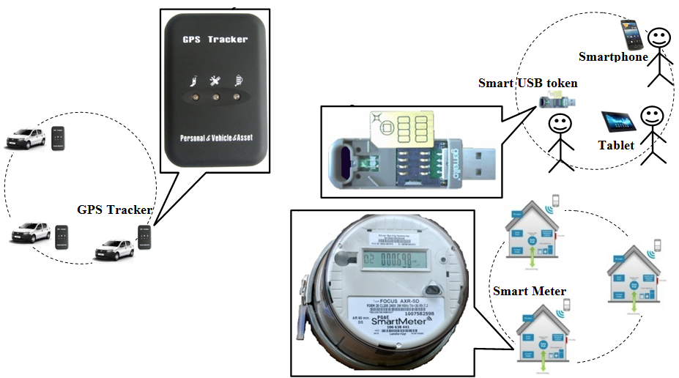
Data produced by secure hardware
Secure hardware is “everywhere”
Where is your personal data stored? … In data centers
Notes:
As you can see, in our daily life, we have a lot of secure devices and they can be at many form such as: GPS tracker installed in a car to store locations or trajectory of the car, or the Smart Meter installed in each house to keep a record about electricity usage, or other device such as the Smart USB token to keep medical records of a person, etc.
But the question is where these data are stored? all of them end up in the central server.
Even the data is produced by secure hardware in distributed way, but we still centralize these data in a central server. Is it a problem?

Slide 8
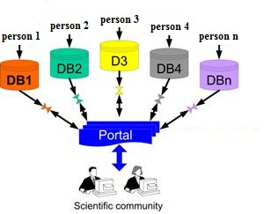
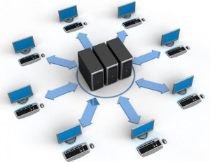
Centralized vs De-centralized
Centralized solutions
Privacy violation
Internal & external attacks on server
Single point of attack
De-centralized solution
Get rid of the assumption of trusted central server
Distributed secure devices
Notes:
The main motivation of this work is to get rid of the necessity of having a trusted central server.

Slide 9
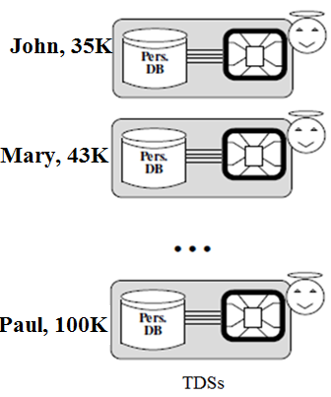
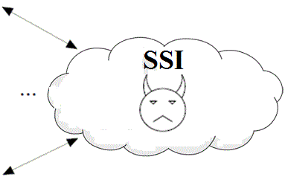
Asymmetric Architecture: Secure Device Trusted Data Server (TDS)
Average salary of Parisiens
Authorized
Querier
Secure Device (Trusted Data Server - TDS) Characteristics :
High security:
High ratio Cost/Benefit of an attack;
Secure against its owner;
Modest computing resources (~10KB of RAM, 120MHz CPU);
Low availability: physically controlled by its owner; connects and disconnects at it will
How to compute global queries on nation-wide dataset over decentralized personal data stores while respecting users’ privacy?
Notes:
The central element of this architecture is the secure device.
Although there are various forms of secure devices, they have 2 components in common: the Trusted Execution Environment and the mass storage area.
Here we show these two components of a Trusted Data Server in more detail. The TEE can be provided by a tamper resistant micro-controller, and the TDS code in this environment cannot be tampered. So, all the computation happened in this area is considered to be safe.
The mass storage area can be provided by a FLASH memory. All the content in this storage is also protected by the encryption.
Because of these secure components, a secure device exhibits high security. But with its small size of memory and low-power CPU, its computing resource is limited. Finally, since these secure devices are controlled by their owners, they has low availability because they can be connected or disconnected at anytime.
So, with this property, an external infrastructure, called SSI, is required to manage the communication between these secure devices and to run the distributed protocol.
The SS is implemented on regular Cloud server , so it has the same low level of trust.
As you see, this architecture is composed by a very large number of low-power, weakly connected, but highly secure TDSs and a powerful, highly available but untrusted SS. We call it the asymmetric architecture.
With this architecture, we allow the Querier to query this decentralized database where data is stored distributed in Trusted Data Server like this.
Our objective is to implement a querying protocol that conform to traditional AC model where only the authorized Querier can gain access to the final aggregation result (but not raw data) and the unauthorized one is not allowed. Also, the data and intermediate result stored in SS must be encrypted to protect the user’s privacy.

Slide 10
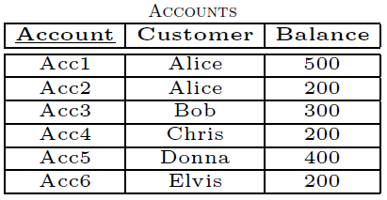
Basic SQL Query
Q1: Select Customer, Balance
From ACCOUNTS
Where Customer = “Alice”
Q2: Select SUM(Balance)
From ACCOUNTS
1800
Q3: Select AVG(Balance)
From ACCOUNTS
300

Slide 11
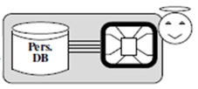
The Generic Protocol
John, 35K
Mary, 43K
Paul, 100K
…
Aggregation phase
Collection phase
Supporting Server
Infrastructure (SSI)
SELECT <attribute(s) and/or aggregate function(s)>
FROM <Table(s)>
[WHERE <condition(s)>]
[GROUP BY <grouping attribute(s)>]
[HAVING <grouping condition(s)>]
[SIZE <size condition(s)>];
Querier
Stop condition: max #tuples or max time
Notes:
here is an overview of our solutions.
In the first step, Querier posts his query to SS. This SQL query is similar to the traditional SQL query, except the SIZE clause that we borrow from the definition of windows in the StreamSQL. This clause is used to indicate the maximum number of tuples to be collected or collection duration.
When TDS connect, it will download this query. Then in the collection phase, these TDS send encrypted data to SS. Then a number of communication between TDSs and SS takes place to produce the final aggregation result of this query. Finally, this result is sent to Querier.

Slide 12
Hypothesis about Querier & SSI
Querier:
Share the secret key with TDSs (for encrypt the query & decrypt result).
Access control policy:
Cannot get the raw data stored in TDSs (get only the final result)
Can obtain only authorized views of the dataset (⇨ do not care about inferential attacks)
Supporting Server Infrastructure:
Doesn’t know query (so, attributes in GROUP BY clause) b/c query is encrypted by Querier before sending to SSI.
Prior knowledge about data distribution.
Honest-but-curious attacker: Frequency-based attack
SSI matches the plaintext and ciphertext of the same frequency.
look at remarkable (very high/low) frequencies in dataset distribution
(e.g., Mr. X with high salary = 1 M€/month and there is only one distinct encrypted salary → Mr. X participates in the dataset).
Notes:
Before moving to our protocol, we state some hypothesis about actors in the architecture.
First, we assume that the querier shares the secret key with TDSs so that he can encrypt the query and decrypt the final result.
Querier also conform to the AC rules in which he cannot get access to the raw data stored in TDSs. He can get only the final result.
He can obtain only the authorized views of the dataset.
About the SS, we assume that he possess the prior knowledge about the data distribution. With this knowledge, he can conduct the frequency-based attack by a number of ways. First, he can match the plaintext and ciphertext of the same frequency to know the plaintext value of the ciphertext. Second, he can look at the remarkable frequencies in the dataset to infer some further information.

Slide 13
Classification of Solutions
Which encryption is used, how the SSI constructs the partitions, and what information is revealed to the SSI
Secure aggregation solution:
Noise-based solutions:
random (white) noise
noise controlled by the complementary domain
Histogram-based solutions:
Performance & Security
Notes:
We propose a number of protocol and we classify them depending on which encryption is used, …
Specifically, the S_Agg uses non-deterministic encryption to prevent the frequency-based attack
In the noise-based, we use the deterministic encryption plus some noise to transform the original distribution. Depending on how many number of fake tuples we generate, we have 3 kinds of noise-based solutions
We can also use the equi-depth histogram to transform the original distribution in the histogram-based solution

Slide 14
Deterministic & non-Deterministic Encryption
Deterministic:
1st: Det_Enc(Alice) = a$%tD4Q
2nd: Det_Enc(Alice) = a$%tD4Q
Non-Deterministic:
1st: nDet_Enc(Alice) = 3f*T$#+
2nd: nDet_Enc(Alice) = 6AW@5!

Slide 15
Secure Aggregation
Q: SELECT SUM(Salary) GROUP BY City
HAVING SUM(Salary) > 50B
(#x3Z, aW4r)
($f2&, bG?3)
($&1z, kHa3)
(Paris, 35K)
(Lyon, 24K)
(Lyon, 43K)
(F!d2, s7@z)
(ZL5=, w2^Z)
(Paris, 35K)
(Lyon, 67K)
Decrypt Q_{i}
Check AC rules
Decrypt Q_{i}
Check AC rules
Decrypt Q_{i}
Check AC rules
Hold partial aggregation (G_{ij},AGG_{k})
…
(#i3Z, afWE)
(T?f2, s!@a)
($f2&, bGa3)
(Lyon, 43K)
(?i6Z, af~E)
(T?f2, s5@a)
(5f2A, bG!3)
(Paris, 35K)
(Nice, 100K)
Evaluate HAVING clause
encrypts its data using non-deterministic encryption
($f2&, bG?3)
Final Agg
(#f4R, bZ_a)
(Ye”H, fw%g)
(@!fg, wZ4#)
Final Result
(#f4R, bZ_a)
(Ye”H, fw%g)
(#x3Z, aW4r)
(T?f2, s5@a)
Supporting Server
Infrastructure (SSI)
Form partitions (fit resource of a TDS)
}
(#x3Z, aW4r)
($f2&, bG?3)
($&1z, kHa3)
…
(T?f2, s5@a)
Q_{i}= <E_{K1}(Q),C,S>
(Paris, 912300M)
(Lyon, 56000M)
Querier
Notes:
To illustrate how the S_agg works, I give you an example of this protocol.
For example, if the energy distribution company wants to find out how much energy a city consume, he can issue this query.
In the first step, Querier sends…

Slide 16
Noise-based Protocols
nDet_Enc on A_{G} ⇨ SSI cannot gather tuples belonging to the same group into same partition.
Det_Enc on A_{G} ⇨ frequency-based attack.
Add noise (fake tuples) to hide distribution of A_{G}.
How many fake tuples (n_{f}) needed? ⇨ disparity in frequencies among A_{G}
small n_{f}: random noise
big n_{f}: white noise
n_{f} = n-1: controlled noise (n: A_{G} domain cardinality)
Efficiency:
Each TDS handles tuples belonging to one group (instead of large partial aggregation as in SAgg)
However, high cost of generating and processing the very large number of fake tuples
Notes:
You can see that the weakness of S_Agg is that if we use nDET_Enc on the grouping attribute, the SS cannot …, so the partial aggregation is very big.
However, if we use Det_enc on grouping attribute, SS can conduct the frequency-based attack.
So, in this Noise-based protocol, we add some noise to hide the original distribution of the grouping attribute.
However, the problem is how many fake tuples we need to add to the true dataset. This depends on the disparity frequencies among grouping attributes. If this disparity is small, we have random noise with small fake data and vice versa. We can also control the noise using the domain cardinality of the grouping attribute.
Compared with the S_Agg, in this solution, each TDS …
That motivates us to propose the next solution that can overcome the weakness of these two solutions.

Slide 17
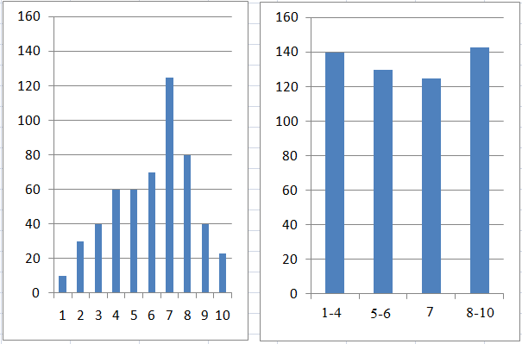
Nearly Equi-depth Histogram
Distribution of A_{G} is discovered and distributed to all TDSs.
TDS allocates its tuple to corresponding bucket.
Send to SSI: {h(bucketId),nDet_Enc(tuple)}
True Distribution
Nearly equi-depth histogram
Not generate & process too many fake tuples
Not handle too large partial aggregation
Notes:
In this solution, the distribution of the grouping attribute must be discovered & deliver to all TDSs first.
And then TDS allocates… After that each TDS sends to SS its tuples in the form … with h is the mapping function that map the grouping attribute to the bucket ID
With this way, the original distribution of the grouping attribute is transformed to a nearly equi-depth histogram, preventing the frequency-based attack.
The strength of this solution is that…

Slide 18
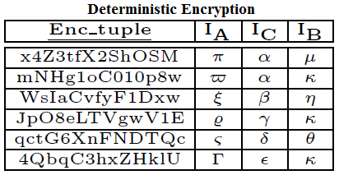
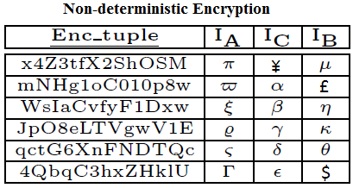
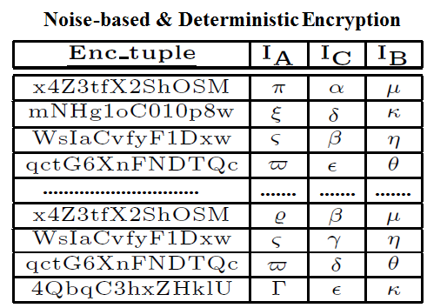
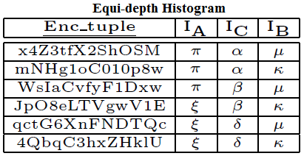
Information Exposure
Notes:
To compare the security among solutions, we measure how much information exposured to SS.
Let’s consider a simple example. Suppose that we have plaintext table like this, it will be encrypted in different ways corresponding to our proposed protocols.
If we encrypt this table using the deterministic encryption, the same plaintext will be encrypted to the same ciphertext, such as the 2 value of Alice in this case is encrypted to the same ciphertext alpha.
However, if we use non-det, the same plaintext will be encrypted to different ciphertext.
If we use equi-depth histogram, the original distribution of the plaintext value will be transformed to a equi-depth histogram like this.
Finally, if we use noise-based, some fake tuples will be injected to the table.

Slide 19
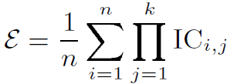
Information Exposure
ɛ: information exposure
n: the number of tuples,
k: the number of attributes,
IC_{i,j} : the value in row i and column j in the IC table
N_{j}: the number of distinct plaintext values in the global distribution of attribute in column j (i.e., N_{j} ≤ n)
ɛ_{S_Agg} ≤ ɛ_{ED_Hist} = ɛ_{Noise_based} < 1
(best) (worst)
Notes:
To measure the exposure, we use the concept of coefficient.
Here we introduce the IC table which is the table of the inverse of the cardinality. The value in each cell of this table is the probability that an encrypted value can be correctly mapped to a plaintext value. For ex, if we use det-enc, the probability that attacker can guess the plaintext value of alpha corresponding to Alice is 1 because he know the distribution of the plaintext table and observes that the ciphertext alpha have highest frequency in the encrypted table.
Generally, if we call n is the number of tuples, k is the number of attributes of the table, ICi’j is the value in each cell of the IC table, then the coefficient of a table is calculated as the average value of the product of each row in the IC table.
When we apply this formula to S_Agg, since it use non-det, the IC value in each cell is 1/Nj, so the coefficient of the S_Agg is calculated like this
For the EDHist, since the encrypted table is mapped to an equi-depth histogram, it requires…
In conclusion, S_Agg is the most secure solution since it has the least information exposure.

Slide 20
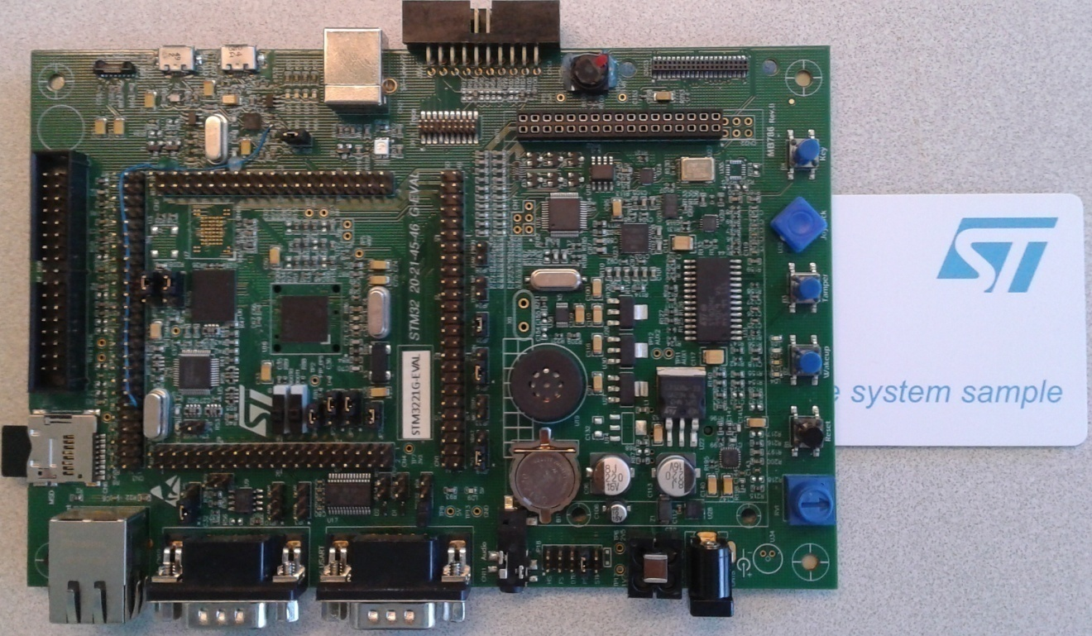
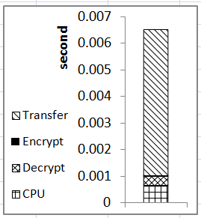
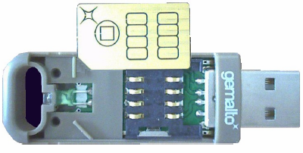
unit test
Internal time consumption
}
32 bit RISC CPU: 120 MHz
Crypto-coprocessor: AES, SHA
64KB RAM, 1GB NAND-Flash
USB full speed: 12 Mbps
Notes:
To do the experiment, we perform the unit test on this development board.
This board is equipped with a low-power CPU which clocked at 120 MHz. It also has a crypto-co processor that can execute the cryptograpphic function like AES or SHA very efficiently.
It has small RAM size and FLASH memory to store data.
It can communicate with the external world through USB full speed.
These hardware characteristic of this board represent a secure token provided by Gemalto, our industrial partner.
We measure on this device the performance of the main operations that influence the global cost, including : transfer, encrypt/decrypt, and CPU time. The result shows that the transfer cost dominates the other cost due to the network latency. The CPU cost is higher than the cryptographic cost because the cryptographic operations are executed efficiently in hardware by the crypto-coprocessor. Encryption time is much smaller than the decryption time because we encrypt only the intermediate result.

Slide 21
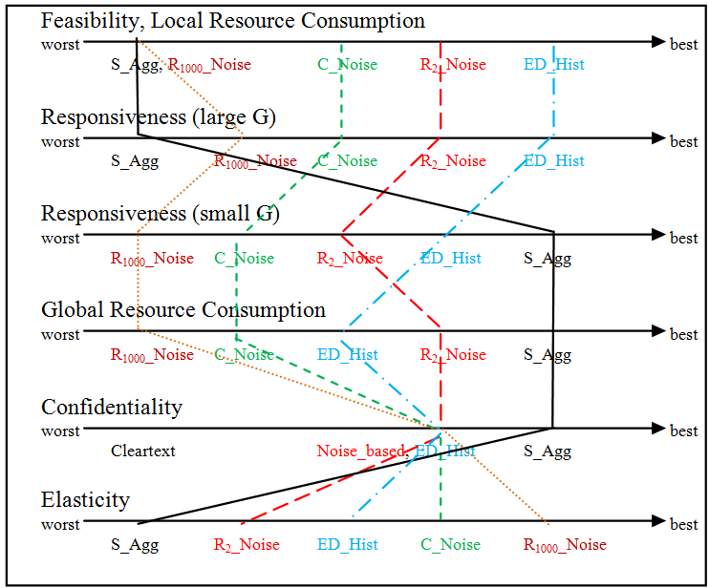
Metrics for the evaluation: Trade-off between criteria
Average Time/Load
Query Response Time
Query Response Time
Total Load
Information Exposure
Resource Variation
Notes:
We propose a number of metrics to evaluate the performance of our protocols and here is the summarize of it.
The local resource consumption refers to the average time that each TDSs spend to compute the query. This metric reflects the feasibility of the protocol because the longer this time, the lower the probability that TDS stay connected during this time. S_Agg is at the worst extreme in this axis since the final aggregation must be done by a single TDS, while the ED_Hist occupy other extreme due to its capacity to share the load evenly among TDS. Noise-based are in between.
This order is reversed in the Global resource consumption which refer to the total size of data that TDSs and SS has to process. This is because the number of TDS used in S_Agg is much smaller than that of EDHist.
Regarding the Responsiveness axis which refer to the Query response time, the relative order of S_Agg and EDHist is different depending on the value of G which is the number of group in the GROUP By clause of the query. If G is big, ED_Hist response much faster than S_Agg and vice verse.
The information exposure mentioned above reflects the confidentiality of our protocols. Clearly, S_Agg is the most secure protocol.
Finally, the elasticity refer to the performance improvement when the computing resource varies. You can see that the S_Agg does not improve too much when the computing resource improves since it does not use too many TDS for the computation. So it has the lowest elasticity. The other protocols are much better.

Slide 22
Which one ?
S_Agg & ED_Hist: best solutions.
ED_Hist: E.g., medical folder; seldom connect; save resource for their own tasks.
S_Agg: smart meter; connect all time; mostly idle; not care resource.
Notes:
You can see that, from this figure, S_Agg and EDHist are the two best protocols in most of the important metrics. So, the question is which one should we choose?
The answer depends on the scenario we are considering.
For ex, if we are considering a context where each individual manage their medical folder embedded in a smart token that is seldom connected , and they want to save the computing resource for their own tasks like updating the data, rather than take part in the global computation, then the EDHist is the best choice for this scenario.
However, if we consider another scenario of a smart meter where they are almost idle and connect all the time, then S_Agg is the most suitable solution for this context.

Slide 23
Future work
Support external joins (i.e., joins between several TDSs).
Extend the threat model to (a small number of) compromised TDSs

Slide 24
Question & Answer

