Slide 1
SMIS: Secured and Mobile
Information Systems
INRIA Paris-Rocquencourt
Joint team with CNRS & University of Versailles (UVSQ)
Junior Seminar
INRIA may 19th 2015

Slide 2
Background and research fields
A Core Database Culture …
  Storage and indexing models, query execution and optimization
  Transaction protocols (atomicity, isolation, durability)
  Database security (access and usage control, encryption)
  Distributed DB architectures

Slide 3
Current composition of the team
Permanent members
Nicolas Anciaux CR INRIA
Luc Bouganim, DR INRIA
Benjamin Nguyen, MC UVSQ, since 2010
Philippe Pucheral, PR UVSQ
Iulian Sandu Popa, MC UVSQ, since 2012
Engineers
Quentin Lefebvre
Aydogan Ersoz
PhD students
Saliha Lallali: Document Indexing for Embedded Personal Databases
Athanasia Katsouraki: Access and Usage Control for Personal Data in Trusted Cells
Cuong To: Secure Global Computations on Personal Data Servers
Paul Tran-Van: Sharing file in Embedded Personal Databases
…
SMIS Project Team
3

Slide 4




A Scalable Search Engine for Mass Storage Smart Objects
SMIS project (INRIA, Prism, Univ. Versailles)
Saliha LALLALI
Nicolas ANCIAUX
Iulian SANDU POPA
Philippe PUCHERAL

Slide 5




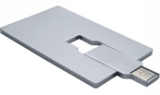

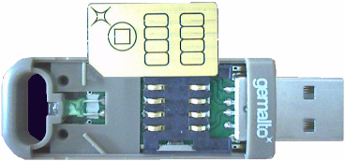


Motivation – Advent of Smart Objects
Personal memory devices
in which a secure chip is implanted
Secure devices on which
a GB flash chip
is superposed
Personal
& secure
devices
①
②
③
④
USB MicroSD
reader
Secure MicroSD
4GB Flash
Contactless + USB
8GB Flash
Sim Card
Application domains
  Personal Data Server
  Personal Cloud / Personal Web
Securely store, query and share personal user’s files and their metadata
  Documents, photos, emails, links, profiles, preferences …
Base required functionality: full text search (similar to an embedded Google desktop or Spotlight)

Slide 6
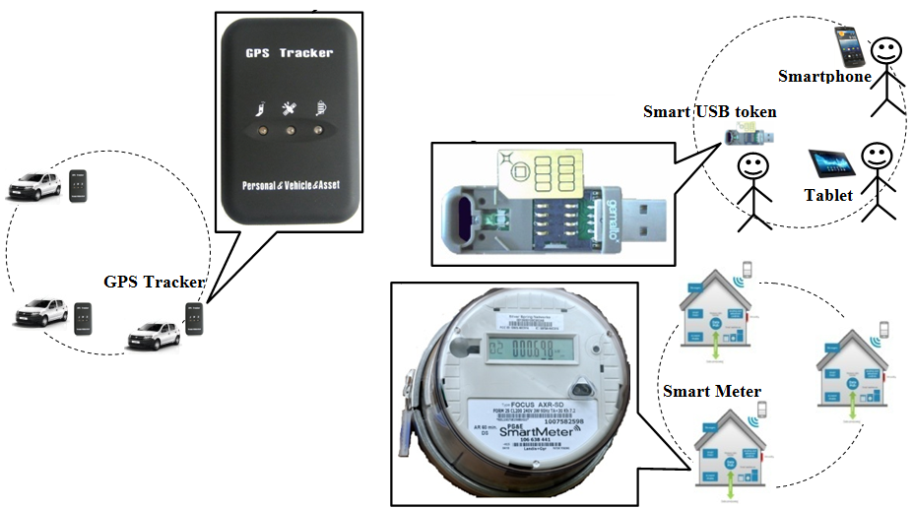

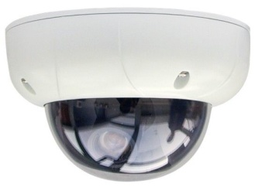
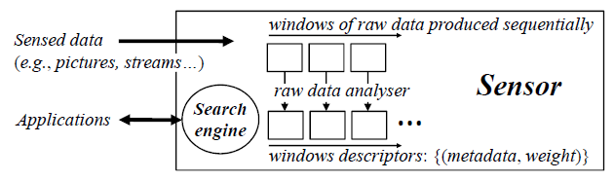
Motivation –
Smart Metering and Internet of Things
Smart meters and IoT
Google glass
Camera sensor
Smart sensor context
  Smart meters/objects (Linky, GPS tracker, set-up box, …)
  Smart sensors recording events in theirs surroundings (camera sensor, Google glass)

Slide 7
Smart Objects and Data Management
Why transposing traditional data management functionalities directly into the smart objects?
Managing large collections of data locally in smart objects exhibits very good properties in terms of:
  Privacy & security
    Data distribution
    Transfer only the results and not the data
  Energy saving
    Avoiding to transmit all the data to a central server
    Transferring few data (the results)
  Bandwidth savings
Several works consider the problem of data management in SOs:
    Basic filtering and SQL query support
    Facial recognition
    Full text search (documents, images: tags/visterms, any tagged data objects)

Slide 8
Full-Text Search Requirements (1)
Inverted index
  A search structure or (a dictionary): stores for each term t appearing in the documents the number F_{t} of documents containing t and a pointer to the inverted list of t
  A set of inverted lists: where each list stores for a term t the list of (d, f_{d,t}) pairs where d is a document identifier that contains t and f_{d,t} is the weight of the term t in the document d
Dictionary organized as a B-tree
t_{i} , F_{ti}
t_{j} , F_{tj}
(d₁, f_{ti,d1}), (d₃, f_{ti,d3}), (d₄, f_{ti,d4})
Inverted list for term t_{i}
(d₅, f_{tj,d5})

Slide 9
Full-text search requirements (1)
Term | F_{t} | Inverted list
and | 1 | (6,2)
big | 2 | (2,2) (3,1)
dark | 1 | (6,1)
did | 1 | (4,1)
gown | 1 | (2,1)
had | 1 | (3,1)
house | 2 | (2,1) (3,1)
in | 5 | (1,1) (2,2) (3,1) (5,1) (6,2)
keep | 3 | (1,1) (3,1) (5,1)
keeper | 3 | (1,1) (4,1) (5,1)
keeps | 3 | (1,1) (5,1) (6,1)
light | 1 | (6,1)
never | 1 | (4,1)
night | 3 | (1,1) (4,1) (5,2)
old | 4 | (1,1) (2,2) (3,1) (4,1)
sleep | 1 | (4,1)
sleeps | 1 | (6,1)
the | 6 | (1,3) (2,2) (3,3) (4,1) (5,3) (6,2)
town | 2 | (1,1) (3,1)
where | 1 | (4,1)
The old night keeper keeps the keep in the town.
In the big old house in the big old gown.
The house in the town had the big old keep.
Where the old night keeper never did sleep.
The night keeper keeps the keep in the night.
And keeps in the dark and sleeps in the light.
« Keeper » Inverted Index
« Keeper » Document Set
Dictionary
Organized as
a B-Tree
t_{i} , F_{ti}
t_{j} , F_{tj}
(d₁, f_{ti,d1}), (d₃, f_{ti,d3}), (d₄, f_{ti,d4})
Inverted list for term t_{i}
(d₅, f_{tj,d5})

Slide 10
Full-Text Search Requirements (2)
Answer full-text search queries
  For a set of query keywords, produce the k most relevant documents (according to a weight function like TF-IDF)
To evaluate the query:
  Access the inverted index search structure, retrieve for each query term t the inverted lists elements
  Allocate in RAM one container for each document identifier in these lists
  Compute the score of each of these documents using the TF-IDF formula
  Rank the documents according to their score and produce the k documents with the highest score
TF-IDF(doc) = Σ (f_{d,ti}* Log( N / F_{ti}))
{t_{i}} query
keywords
too much!

Slide 11

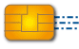
Smart Object HW Architecture
Smart objects share a common architecture
(Secure) Microcontroller
  Low cost
  But small RAM ( 5KB ~ 128KB)
NAND Flash
  Dense, robust, low cost
  But high cost of random writes
    Pages must be erased before being rewritten
    Erase by block vs. write by page
Tiny RAM and NAND Flash introduce conflicting constraints for data indexing
MCU
BUS
NAND
FLASH
How do existing techniques deal with these constraints ?

Slide 12
Problem Statement
Challenge: execute queries with a very small RAM on large volumes of data indexed in NAND Flash
Query time
Insert-optimized family
Sequentially write the index in Flash
Small indexed structure (hash function with a small number of buckets indexed in RAM)
Updates not supported!
Query-optimized family
Update the index in place
Insertion time
Objectives of the proposed solution: Bounded RAM (a few KB) & Full Scalability (both for updates and queries)
Design principles
  Write-once partitioning (update scalability)
  Linear pipelining (query evaluation under a Bound RAM)
  Background merging (query/update scalability)

Slide 13
Principle1: Write-Once Partitioning
Split the inverted index structure in successive partitions such that a partition is flushed only once in Flash and is never updated.
I₁
I₂
I₃
I_{p}
…………
…………
…………
FLASH
RAM
RAM _Bound

Slide 14

Principle2: Linear Pipelining
For a Q = {t₁, t₂,….,t_{n}} :
$$\left[\sum_{ti∈Q}{ W(f_{d,t}∗\log\left(\frac{}{}\right))} \right]$$
a global metadata
N
Top_{k}
N
F_{ti}
F_{ti}
I1
I2
I3
Ip
t_{i},f_{ti}
t_{i},f_{ti}
t_{i},f_{ti}
t_{i},f_{ti}
…………
t_{i},f_{tj}
FLASH
RAM
page
page
…
insert
(d, s)
= f_{ti}
+ f_{ti}
+ f_{ti}
+ …
+ f_{ti}
s > min
top-k
F_{t1}
, F_{t2}
, F_{t3}
,…
,F_{tn}
merge
on d
s←score(d)
…
min

Slide 15
Principle3: Background Linear Merging
L0
L0
L0
L0
I ₁
I _{b}
I ₁
I ₂
L₀
…
………
………
merge
merge
merge
merge
I_{1,1}
I_{1,b}
I_{1,1}
I_{1,2}
L₁
…
inverted lists
for term t_{i}
merge
I_{2,1}
L₂
order of the scan when
querying the index
Active partition
Reclaimed partition
SSF (Scalable and Sequential Flash structure)

Slide 16
Document Deletions (1)
Implementing the delete operation is challenging :
  Index updating → Random updates in the index
  State of the art embedded search indexes do not support/consider document deletions/updates
The alternative to updating in-place is compensation:
  Store the Deleted Document Identifier (DDIs) as a sorted list in Flash
  Intersect DDIs lists at query execution time with the inverted lists of the query terms
Compensation problems:
  Random documents deletion → maintaining a sorted list of DDIs in Flash
  violate the Write-Once Partitioning principle
  The F_{t} computation need an additional merge operation to subtract the sorted list of DDIs from the inverted lists for each term in the query
  the full DDI list has to be scanned for each query regardless of the query selectivity
  violate the Linear Pipelining principle

Slide 17
Document Deletions (2)
Retained deletion method:
  Compensate the index structure itself:
    A pair of (term, d, - f_{d,t}) is inserted in I_{i} for each term in the deleted document d
    f_{t} of each term t in d is decremented by 1
The objective is threefold:
  Preclude random writes Write-Once Partitioning principle
  Query selectivity Linear Pipelining principle
  Absorb the deleted documents in Background Merging

Slide 18
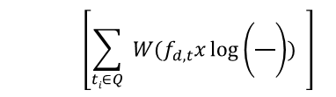
Document Deletions (3)
Query:
$$\left[\sum_{ti∈Q}{ W(f_{d,t}x\log\left(\frac{}{}\right))} \right]$$
a global metadata
N
Top_{k}
N
F_{ti}
F_{ti}
I1
I2
I3
Ip
t_{i},f_{ti}
t_{i},f_{ti}
t_{i},f_{ti}
t_{i},f_{ti}
…………
t_{i},f_{tj}
FLASH
RAM
d∉stock
page
page
no
d< max
yes
insert
(d, s)
no
insert
(d, s)
…
yes
check
flash
stock
= f_{ti}
+ f_{ti}
+ f_{ti}
f_{d,t}< 0
+ …
+ f_{ti}
max
F_{t1}
, F_{t2}
, F_{t3}
, F_{tn}
d
,…
s > min
…
…
purge
s< min
s
merge
on d
s←score(d)
min
Ghost
top-k

Slide 19
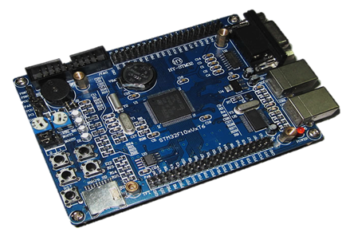
Experimental Evaluation
HW platform:
  development board ST3221G-EVAL
    MCU STM32-F217IG and microSD card
    Storage on two SD cards (Silicon Power SDHC Class 10 4GB & Kingston microSDHC Class 10 4GB)
  Index RAM bound = 5KB
    SSF branching factors: b=8 and b’=3
Datasets and query sets
  PDS/Personal Cloud use-case: “rich” documents
    very large vocabulary (500k terms) and documents (more than 1000 terms per doc on average)
      ENRON email dataset: 500k emails (946MB of raw text)
      Pseudo-desktop dataset (CIKM’09): 27k documents, i.e., email, html, pdf, doc and ppt (252 MB of raw text)
  Smart sensor use-case: “poor” documents
    moderate vocabulary (10k terms) and documents (100 terms per doc on average)
      Synthetic dataset: 100k documents (129MB of raw text)

Slide 20
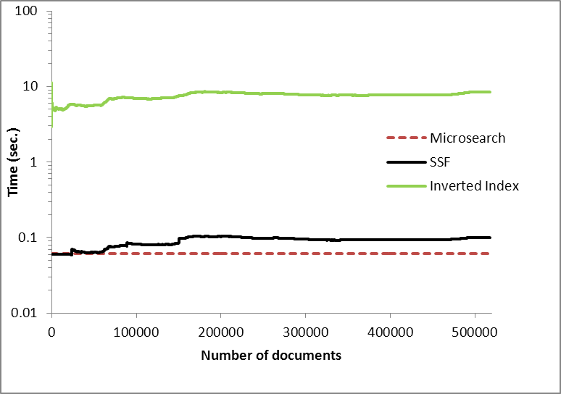
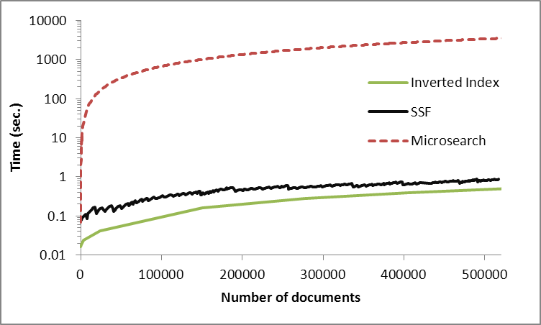
Comparison with the State-of-the-Art Search Engine Methods
a. Average document insertion times of Microsearch, SSF and the Inverted Index with Silicon Power storage.
b. Query execution times with the Inverted Index, SSF and Microsearch with Silicon Power storage

Slide 21
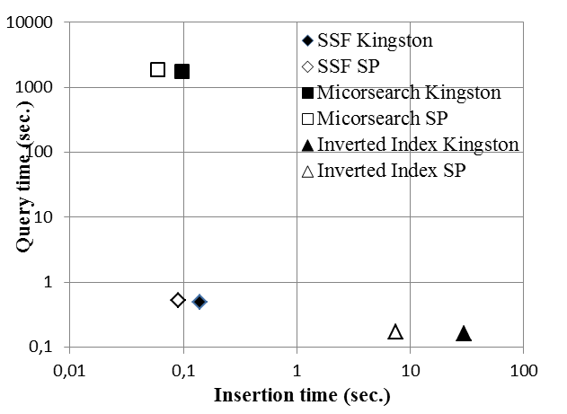
Comparison with the State-of-the-Art Search Engine Methods
Overall performance comparison

Slide 22
Conclusion & Future Work
We presented an embedded search engine for smart objects equipped with extremely low RAM and large Flash storage
Our proposal is founded on three design principles, to produce an embedded search engine reconciling high insert/delete rate and query scalability
Our inverted index supports document deletions, while the state-of-the-art embedded search indexes do not consider document deletions.
Future work :
Efficient tag-based access control using the embedded search engine
Apply our 3 designs principle (Write-Once Partitioning, Linear Pipelining, Background Merging) to other indexing structures for smart objects

Slide 23
Merci !
Questions/suggestions ?

