Slide 1

Modeling tumor development in liver
Séminaire des doctorants
William Weens
BANG, Inria
November 15th 2011

Slide 2
Outline
Cancer
Systems Biology
Mathematical description
Application to liver tumor
Conclusion

Slide 3
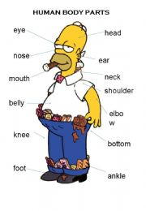
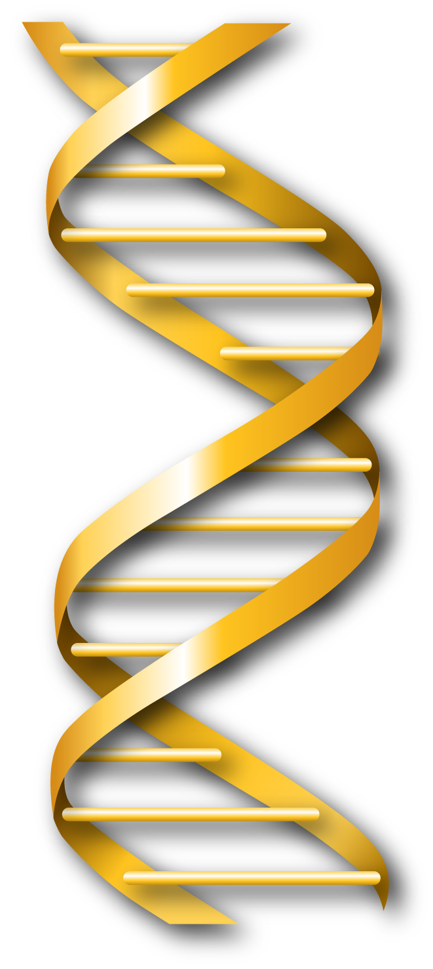
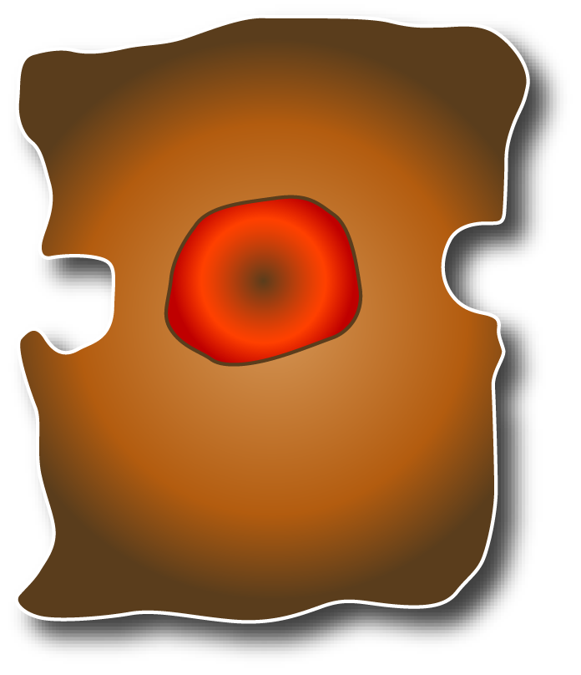
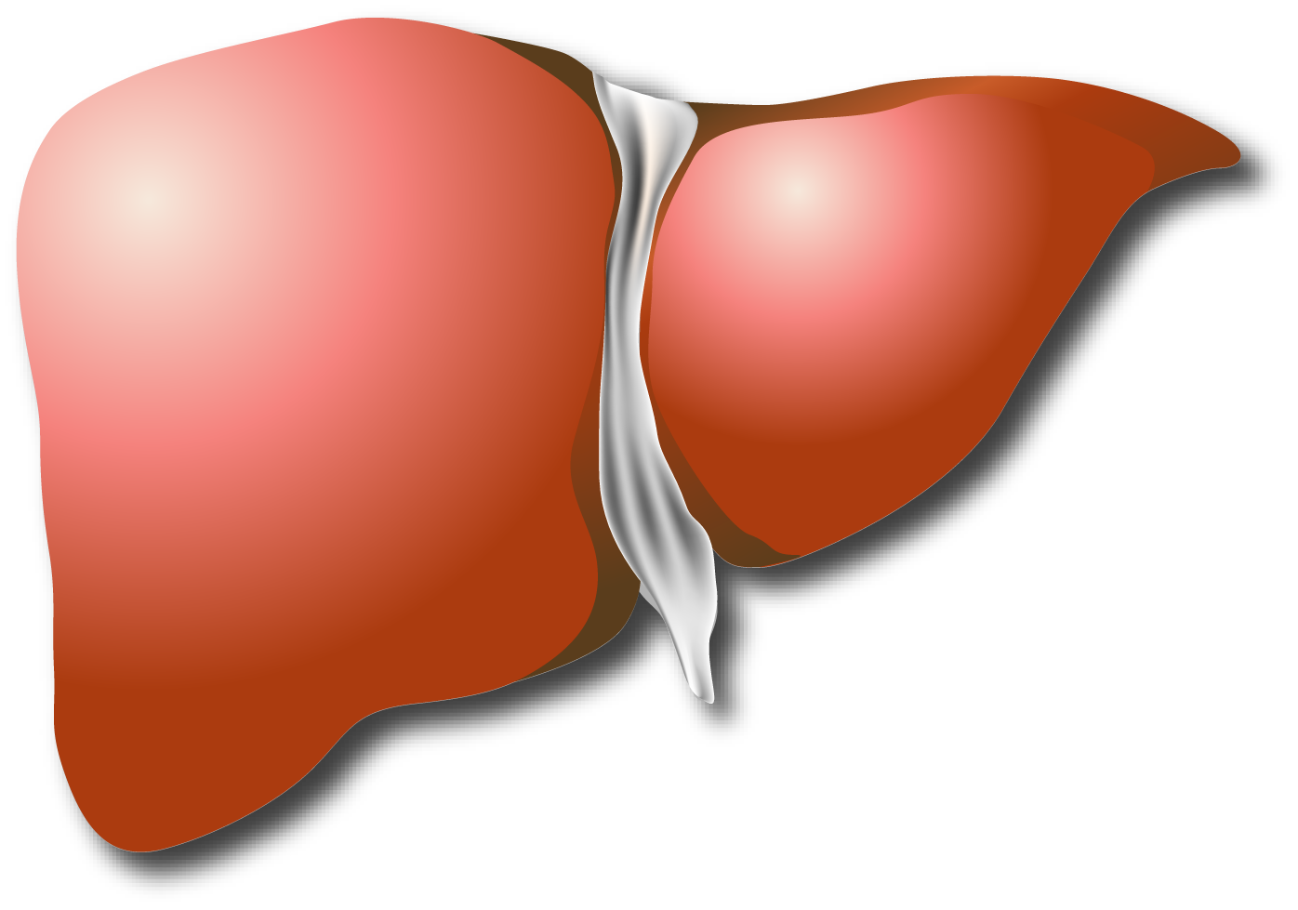
What is cancer?
Definition: Cancer is an abnormal cell proliferation caused by genetic mutations.
Simplified Example:
Aggressive Cell
Organ not functional
DNA mutations
Disorder in tissue
Disease or death
Our purpose is to help to understand part of the mechanisms.

Slide 4
Cancer over the world
Data from 2008:
  Cancer is the leading cause of death worldwide.
  Liver cancer is the 3rd most killer (700 000 death per year)
  Among liver cancers, hepatocellular carcinoma (HCC) is the most frequent.
Different liver diseases are responsible for HCC:
  Hepatitis B,C
  Alcoholism
  Aflatoxin B1
Studying cancer is critical health issue and of course an important economic issue.
Source: World Heath Organization (WHO)

Slide 5
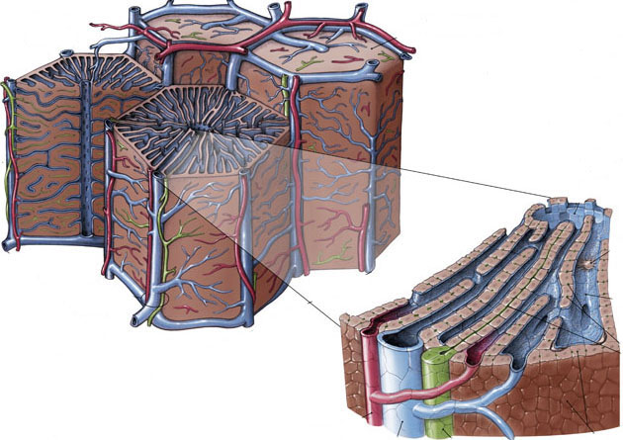
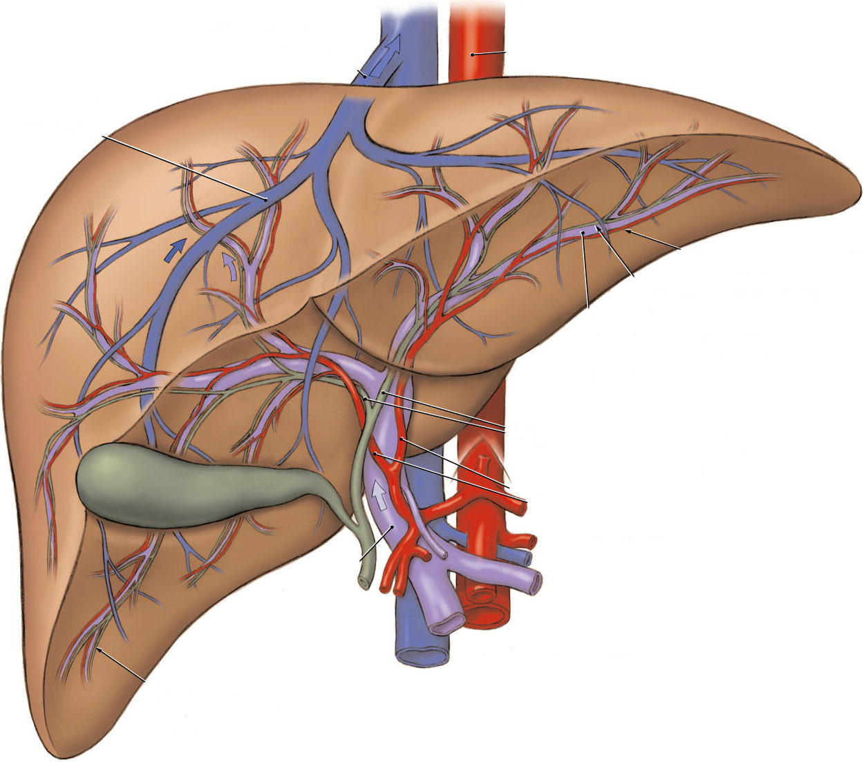
Liver: an adaptated architecture to its function
Lobule hépatique
Liver function is to filter the blood:
  to remove raw materials
  to deliver important molecules
Travée hépatocytaire
Veine
centrilobulaire
Veine
hépatique
Foie
Artère hépatique
Veine porte
epithelium
biliaire
hépatocyte
Parenchyme hépatique
Liver cells (hepatocytes) are organized to optimize those functionalities.
Canal biliaire
Artère hépatique
Veine porte

Slide 6
Systems Biology
Systems biology is the science field that deals with different biology scales and tries to link them together – using physical and chemical laws.
Information | Scale
Gene mutation | Molecule
Derivation of cell phenotype | Cell
Modification in lobule architecture | 10^4 cells
Global effect on liver | Tissue
Impact on metabolism | Human Body
Notes:
- The final goal is the treatment pf patients
Present the different scale of the problem (and introduce the biological problem)

Slide 7
Systems Biology
Systems biology is the science field that deals with different biology scales and tries to link them together – using physical and chemical laws.
Information | Scale
Gene mutation | Molecule
Derivation of cell phenotype | Cell
Modification in lobule architecture | 10^4 cells
Global effect on liver | Tissue
Impact on metabolism | Human Body
Our expertise is the cell-scale (from 1 to 100 000 cells) and its physical interactions (modeled by Agent-Based model)
Notes:
- The final goal is the treatment pf patients
Present the different scale of the problem (and introduce the biological problem)

Slide 8
Philosophy ?
A systems biology approach
Pilote experiment that gives the main idea
Experiment
Data analysis
Quantitative modeling
Model prediction
Notes:
The key point is the comparison with experimental data
- Model Validation is an experiment
Describe here the philosophy of mathematical modeling. Explain how we work and hope to find result.

Slide 9
Simulation Principle
Simulate cancer in a “in real” situation with different parameters and properties
Select plausible results
Understand cancer mechanisms
β-Catenin activation
(or APC knock-out)
Phenotype modification
Impact on the lobule architecture ?
Examples of cell parameters and properties we can change:
Proliferation rate
Death rate
Vessel stiffness (blood vasculature flexibility )
Etc.
Notes:
What the difference with the way the biologist model ?
What we do is: We try to link genetical changes (APC-knockout) in single cells to phenotypical changes in that cells and their offspring (the things that you listed) [often by image analysis] and then analyze the impact of such changes on the lobule or multi-lobule level (architectural changes, regeneration velocity etc.) [often by modeling].
Here starts the main purpose: tell the whole story.
Why do we think that our model will help ?
Because by testing we want to show-
the complete movie (experiment can’t) of the process
You should explain this very clearly because this is an important thing for the biologists to understand.

Slide 10
Cell interactions mathematical description
How does cell i move and how it interacts with cells j?
Langevin equation for cells motion
t = time
Effective
friction
constant
friction
between
cells
forces
(cell/cell,
cell/substrate)
Active migration
+
=
+
velocity
Blood vessels (small + large) modelled as semi-flexible chain of spheres linked by springs
Notes:
J is the index for interacting cells. Here: two interactions forces: adhesion/repulsion and friction.
Vessels are modeled as other agent with an additional elastic force to link them as a network.
Image for each term
Animation/image for blood vessel

Slide 11
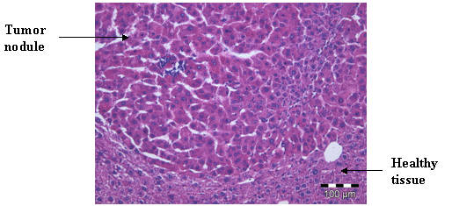
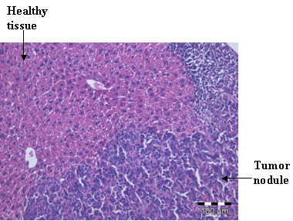
Application to HCC
In experiments we observed two phenotypes: well-differentiated and poorly-differentiated.
What are the relevant and minimal changes that could explain both phenotypes?
Poorly differentiated
Well differentiated tumor

Slide 12
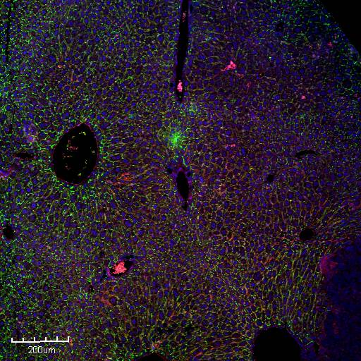
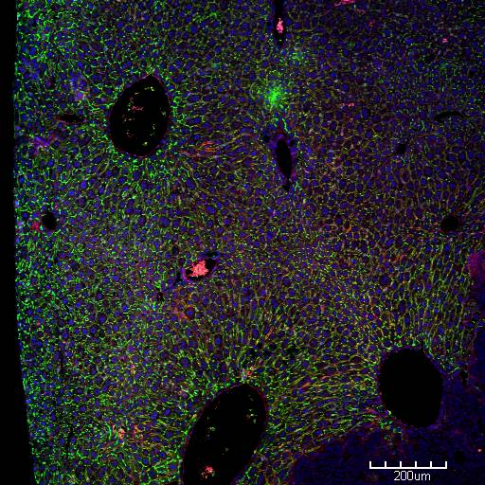
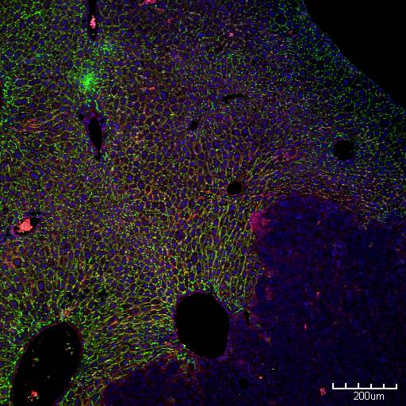
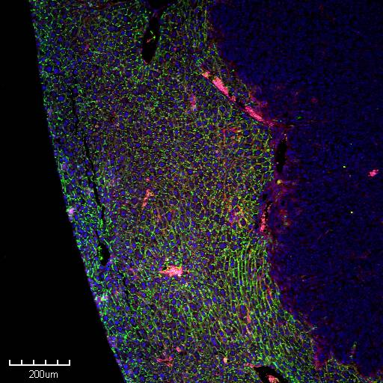
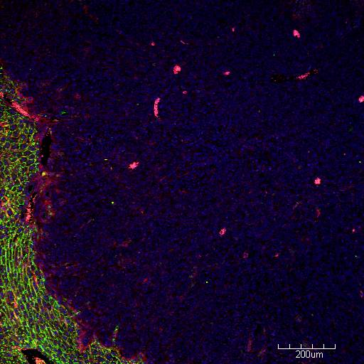
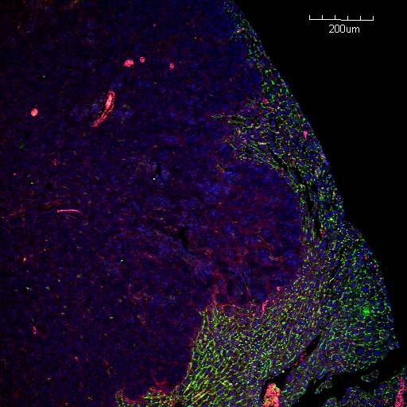
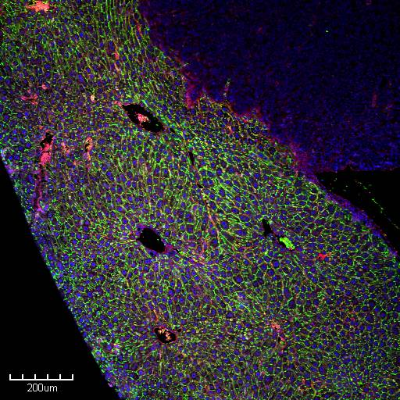
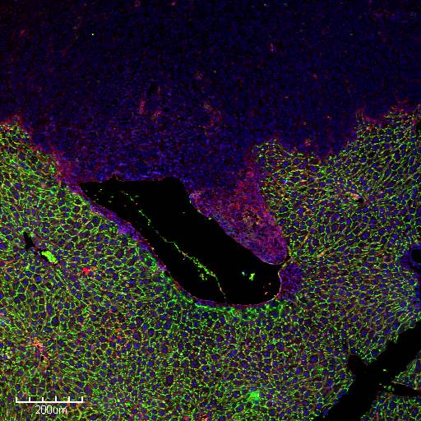
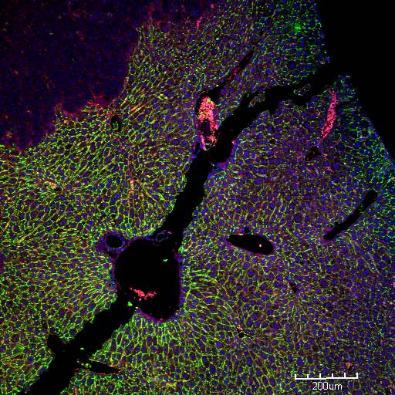
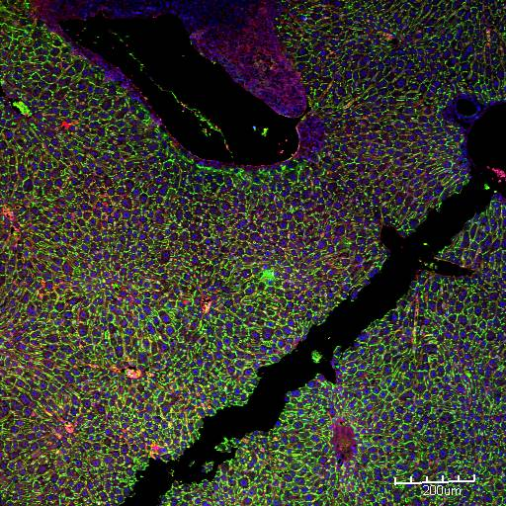
Poorly differentiated
Sabine Colnot - samples Paraffin section, Collage and staining IFADO
Notes:
Expliquer ce que représente les couleurs

Slide 13
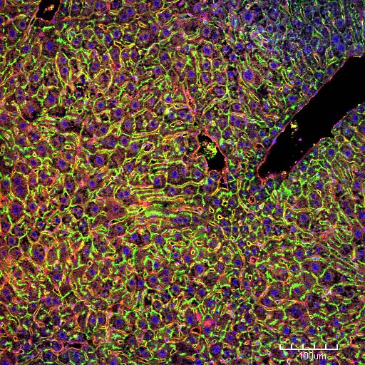
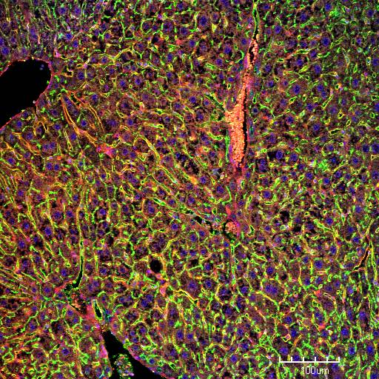
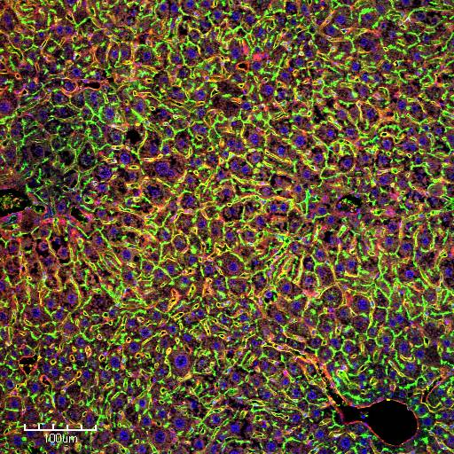
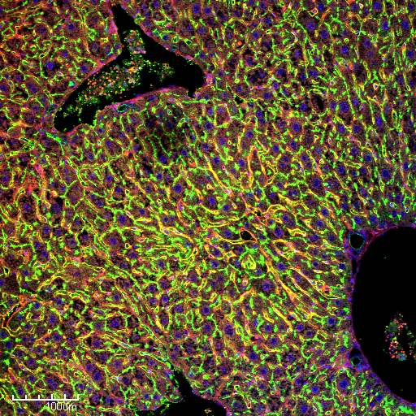
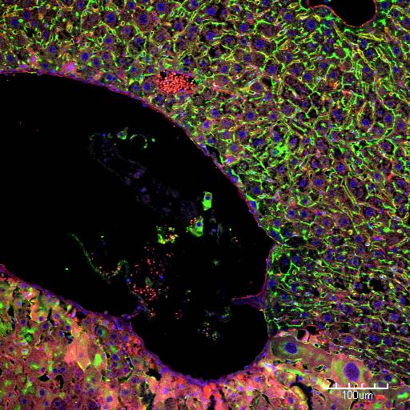
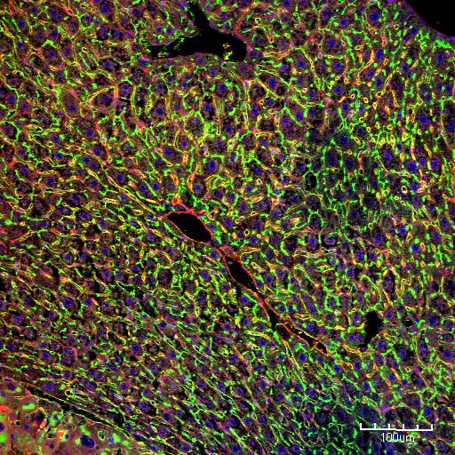
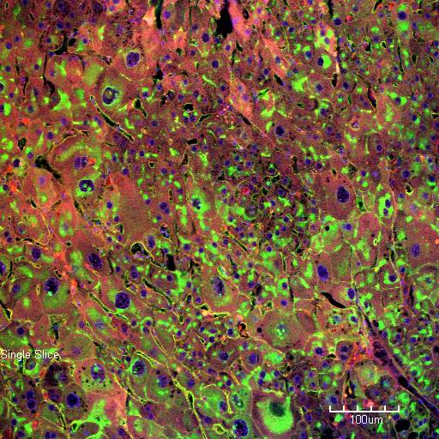
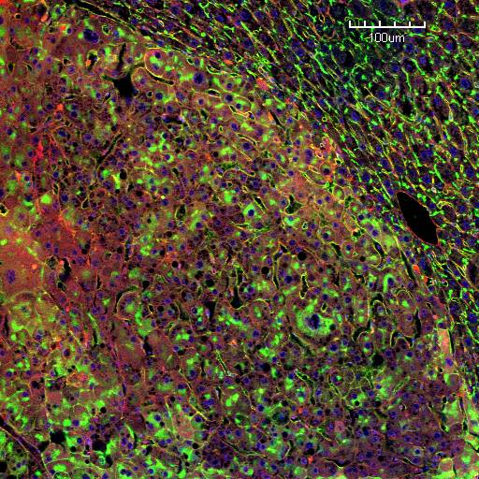
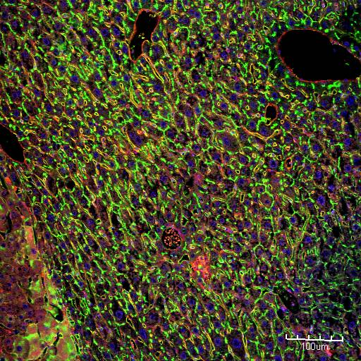
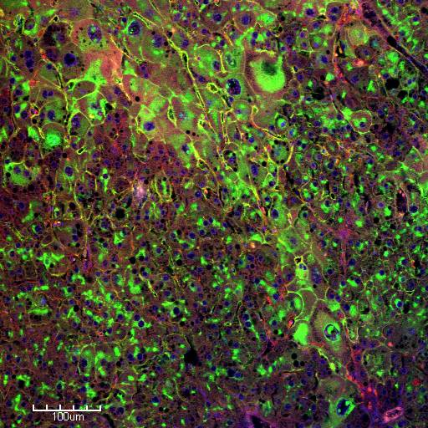
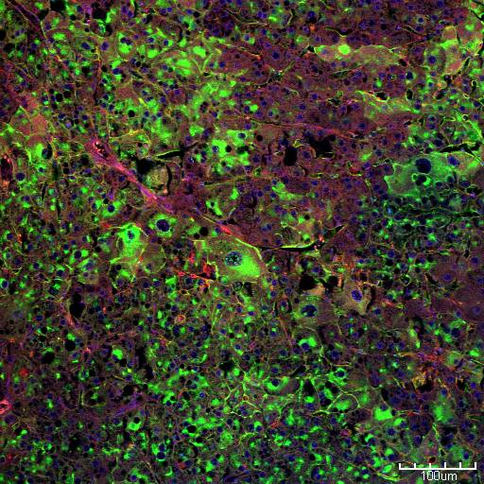
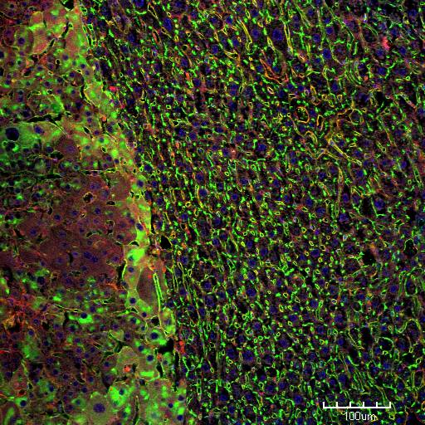
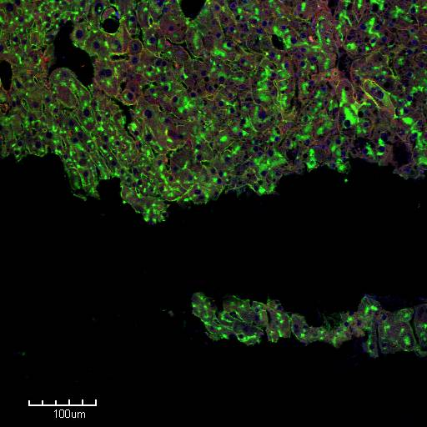
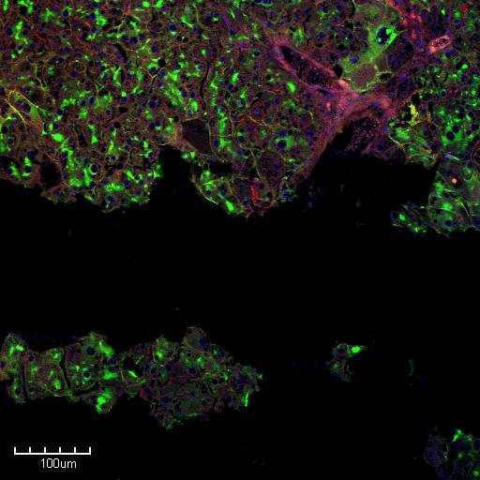
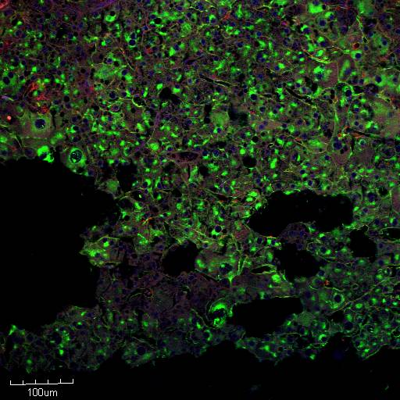
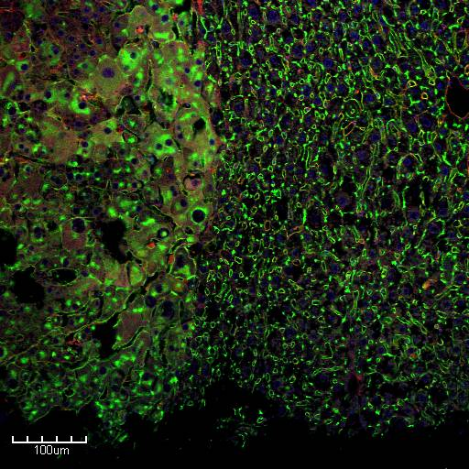
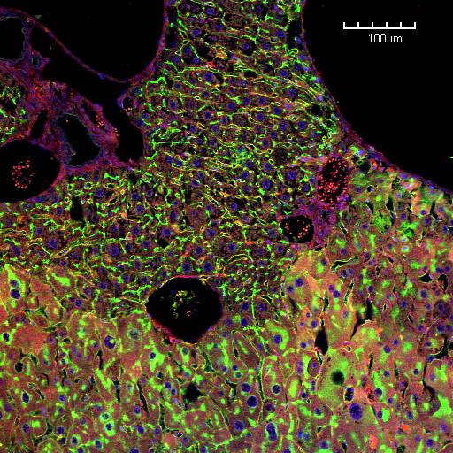
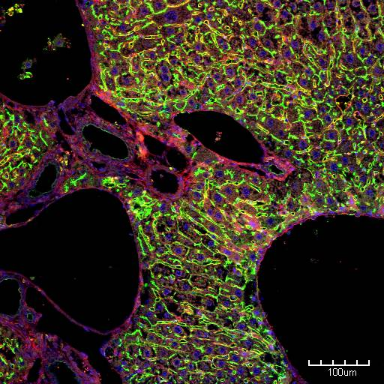
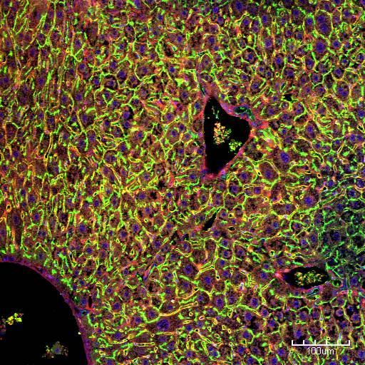
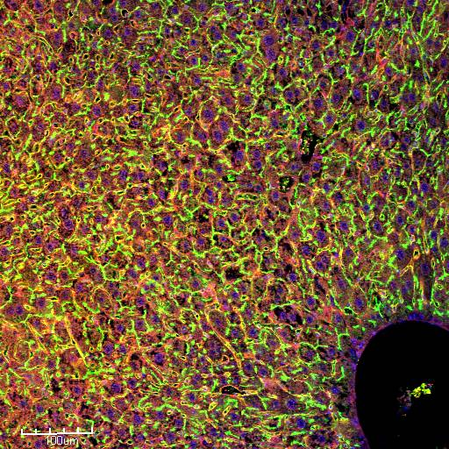
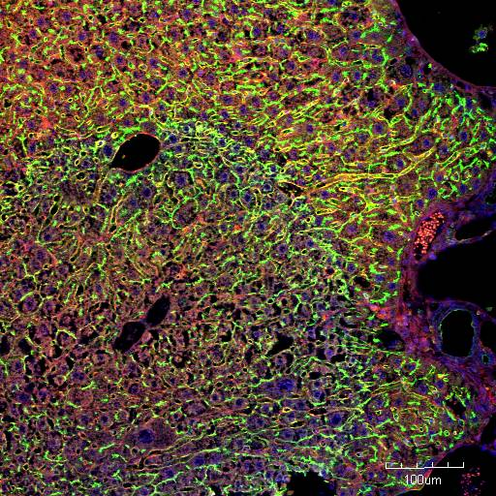
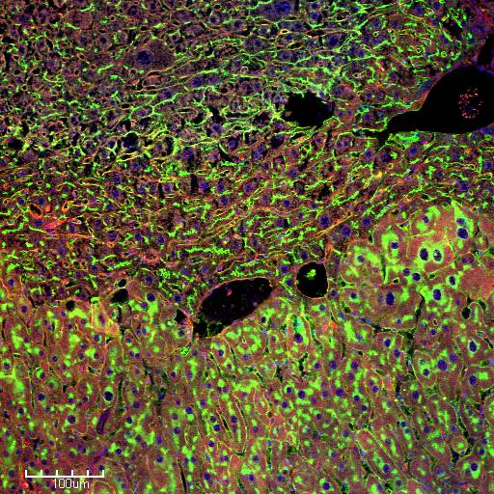
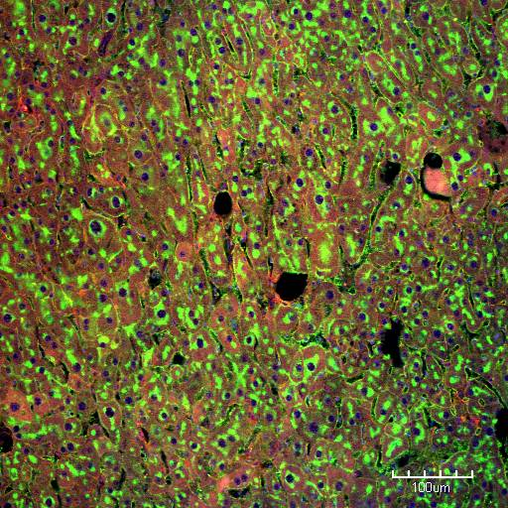
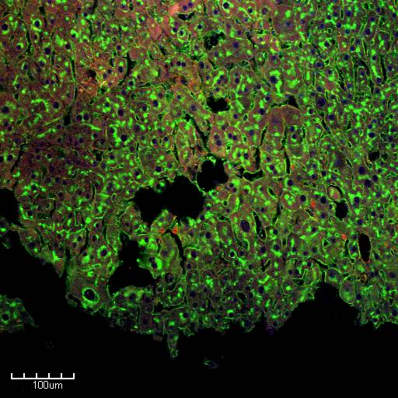
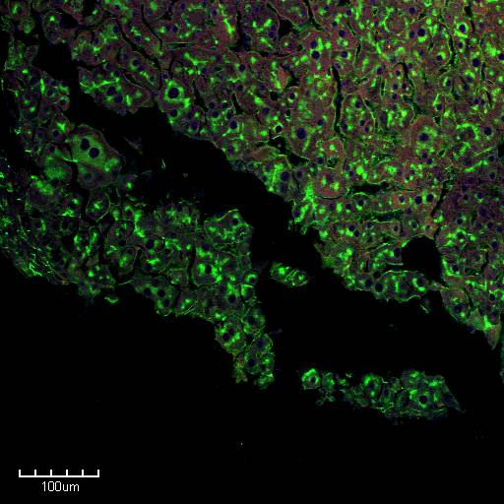
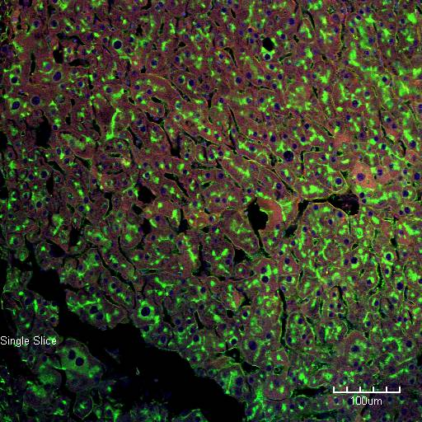
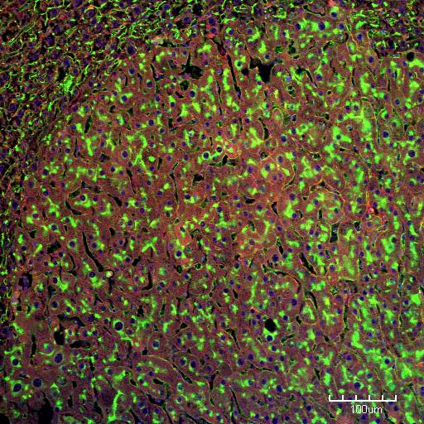
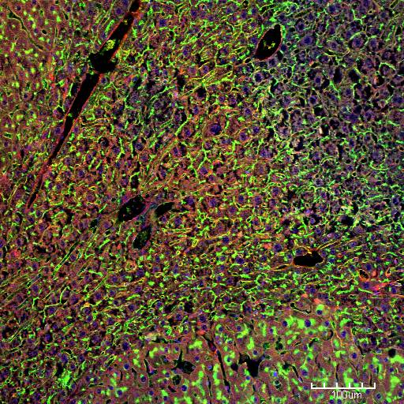
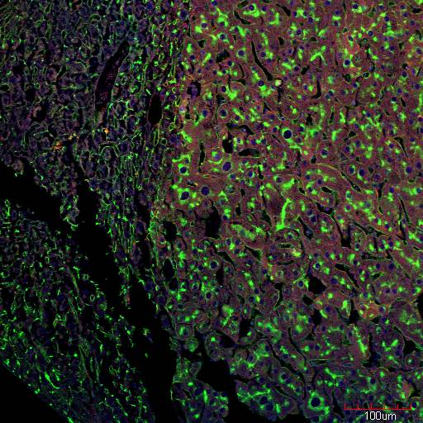
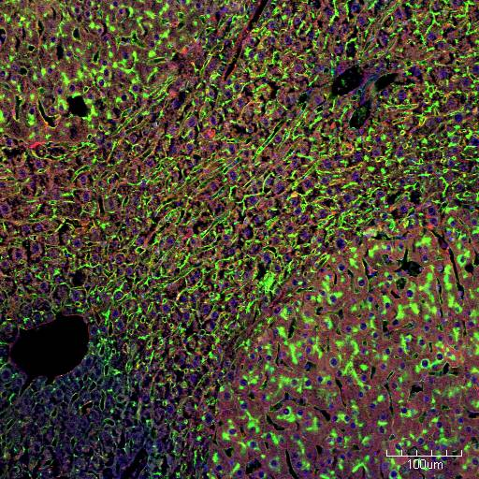
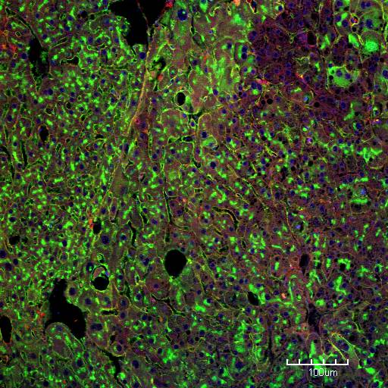
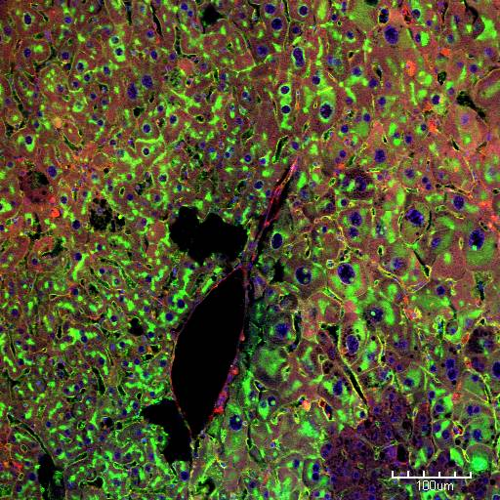
Well differentiated tumor
Sabine Colnot - samples Paraffin section, Collage and staining IFADO

Slide 14
Comparison of phenotypes
Property | Well-differentiated | Poorly-differentiated
Size (observation) | bigger | Smaller
Adhesion (quantified) | Yes | No
Those differences are not able alone to explain the well-differentiated phenotype
Notes:
Show two simulations(with the different phenotype) + wrong

Slide 15
The liver model: building blocks
Tumor Cells
With different phenotypes
- Rates: Proliferation/death
- Physic: Adhesion, motility,…
- Mechanisms: cell-cycle,…
Vascular System
With different components
- sinusoids
- portal veins
- central veins
- Bile duct
Hepatocytes
Notes:
Each cell is represented as an agent

Slide 16



Vessel stiffness analysis
Infinite stiffness
1000 Pascal stiffness
The vessel density within the tumor nodule is correlated with the ability of the tumor to push the vessels away.
20 Pascal stiffness
Notes:
Healthy Hepatocytes: brown Central Vein: Blue
Apoptotic Hepatocytes: Red Portal Vein: Purple
Sinusoids: Red Tumor cells: active -> White quiecent -> gray

Slide 17
Scenario 1: unrestricted proliferation
High vessel density
poorly differentiated Tumor
Normal vessel density
Low vessel density
Tumor cells elevate their critical pressure at which they enter quiescence above the value at which vessels can be pushed aside (without dying).
Tumor border
Normal tissue
This situation is not observed in experiments

Slide 18
Scenario 2: resistant vasculature
High vessel density
Well
differentiated Tumor
Normal vessel density
Low vessel density
Tumor cells replace healthy cells without destructing the liver vasculature. Cells are said well differentiated because they behave almost like normal hepatocytes
Tumor border
Normal tissue
This situation is observed in well differentiated tumors

Slide 19


High Vessel Stiffness
The tumor grows and finds its path around the vessel. When there is no more free spaces, the tumor has to kill its surrounding healthy hepatocytes.
Active Tumor: white
Quiescent Tumor: gray
Mitotic Tumor: blue
Central Vein: dark blue
Sinusoid: red
Hepatocyte: transparent and brown
Endothelial Cell Density remains equal over time
The tumor cells density
Full environment with
a cut in visualization
Only Tumor cells and
vasculature

Slide 20


Tumor’s Vessel Digestion
The tumor growths and destroys the blood vessel by compression.
The tumor cells density
Endothelial Cell Density:
Endothelial Cells are destroyed within the tumor
Before being killed SEC are pushed
From a simulation with vessel desctruction

Slide 21
Scenario 3: vasculature destruction
High vessel density
poorly differentiated Tumor
Normal vessel density
Low vessel density
Tumor cells may secrete proteolytic enzymes, weakening the cell-cell contacts of endothelial cells to eventually destructing them.
Tumor border
Normal tissue
This situation is observed in poorly differentiated tumors

Slide 22
Conclusion
Biomechanical effects alone can reproduce most of the different observed phenotypes
The model is able to reproduce biological data and to confirm or invalidate some assumptions on the tumor cell phenotype
Thanks to exchange with biologist the model is more and more precise and realistic
At the same time, biologists used our results to make new assumptions and experiments

Slide 23
We are currently analyzing simulation with asymmetric liver cells

Slide 24
Thank you

