Slide 1
Dynamic Synthesis of Mediators in Pervasive Environments
Amel Bennaceur supervised by Valérie Issarny
ARLES
14 February 2012, Junior Seminar, INRIA

Slide 2
Outline
My team, my project, my thesis
Interoperability through dynamic synthesis of mediators
Reflections
My team, my project, my thesis
Interoperability through dynamic synthesis of mediators
Reflections
Notes:
Introduce modeling, matching and synthesis from the beginning
Give the intuition from the beginning
Give an (intuitive) example right from the beginning ----
Concentrate on the motivation and the pb ---
Put it later

Slide 3



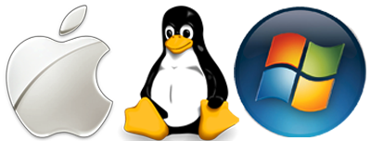

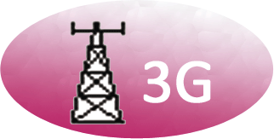


My Team: ARLES
Middleware for pervasive,
distributed computing
Software Architectures for Distributed Systems
  enabling the pervasive computing/ambient intelligence vision
Middleware for pervasive, distributed computing
System Models
System Architecture
Quality of Service
Interoperability
Abstracting pervasive networks and resources
Leveraging highly dynamic and heterogeneous networking environments
Runtime Composition, Reconfiguration, and Adaptation
Connect Project
Access and Interaction
Discovery
Multi-device
Multi-platform
Multi-radio
Notes:
Goal: Leveraging today's rich networking environment towards enabling the pervasive computing/ambient intelligence vision
Approach: Engineering of middleware-based systems, by introducing novel middleware and associated programming abstractions
Our challenges focused on enabling pervasive computing
Define: middleware, pervasive computing
Better explain each block and illustrate..

Slide 4
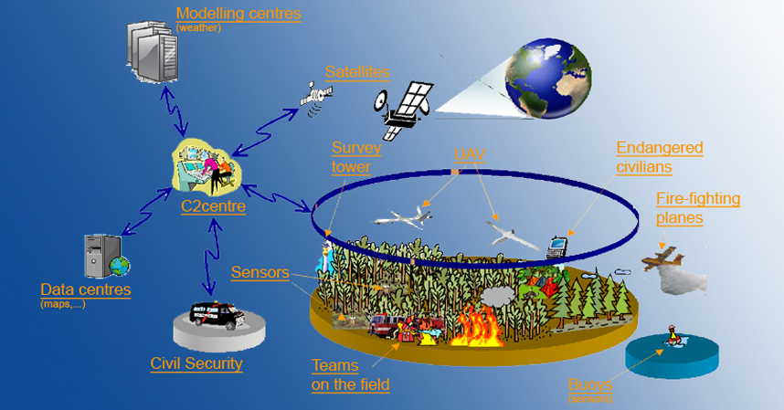


Illustrating the Interoperability Challenge
GMES: Global Monitoring for Environment & Security
Discovery
, Interaction
, Data
, Application
, NFP
heterogeneity
What kind of data can I exchange with other peers?
Am I allowed to forward data to other peers?
What are the available services in vicinity?
How can I communicate with other peers?
What kind of application can I use?
Highly-dynamic and complex environments
Notes:
Investigating the role of contemporary computing technologies, particularly where pervasive technologies meet distributed systems in supporting the (real-time) monitoring and management of the natural environment
Consider moving forward
Consider highlighting hetereogeneity
Use to define then to illustrate

Slide 5
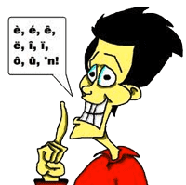
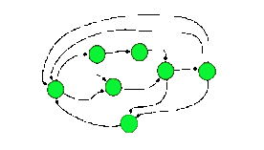
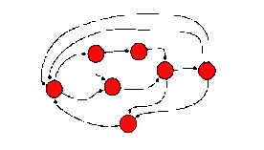
Existing Approaches to Interoperability
Changing systems
×
Change the system or attach an adaptor
Legacy systems
Code unavailable
System1
System 2
Notes:
May be have a recap of the previous approaches

Slide 6

Existing Approaches to Interoperability
× Changing systems
Standardization
×
A chosen shared language
Tanenbaum & Van Steen:
“the extent by which two implementations of systems from different manufacturers can co-exist and work together by merely relying on each other’s services as specified by a common standard”
No one-size-fits all standard given
the heterogeneity and complexity
of pervasive systems (and systems of systems)
System1
System 2

Slide 7
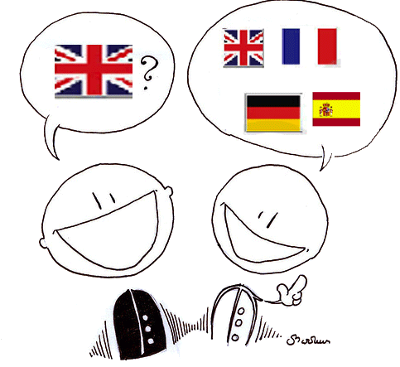
Existing Approaches to Interoperability
× Changing systems
× Standardization
Common Abstraction
×
One speaker talks the other’s language
Use an abstraction to design the component
Need to be aware a priori about all the possible configurations
System1
System 2

Slide 8
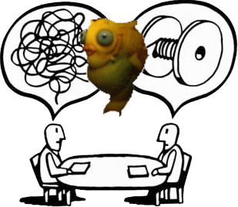
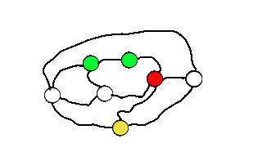
Approaches to Interoperability
× Changing systems
× Standardization
× Common Abstraction
Mediation
✓
Babel fish
Transform on the fly
using an intermediary system: the mediator
Can we observe, synthesize and deploy mediators dynamically?
System1
System 2

Slide 9
Thesis Statement
Systems with compatible functionalities should be able to interact despite heterogeneities in their data and behavioral models.
Mediators that seamlessly overcome these heterogeneities should be dynamically synthesized and deployed in their environment.

Slide 10
Dynamic Mediation to Support Interoperability
Discovery
→ Learning
→ Synthesis
→ Concretization
→ Monitoring
Ontology
DownloadPhoto = getPhoto
Photo = PhotoMetadata + PhotoFile
PhotoMetadata = PhotoID + Location + CameraID + details …
Modeling
Synthesis
Synthesize
Mediator Model
write PhotoMetadata
Model
level
DownloadPhoto
read PhotoMetadata
write PhotoFile
downloadPhoto
read PhotoFile
Model
Extraction
Model
Extraction
Deployment
Deployment
System (NS1)
System (NS2)
System
level
Emergent Middleware
write PhotoMetadata
DownloadPhoto
write PhotoFile
Monitor
Notes:
Recall the pb and the motivation of the thesis
Ontologies have not been introduced
Avoid reification, networked system
Labels on the models too small, remove model from the boxes
The ontologies defines the vocabulary

Slide 11
Outline
My team, my project, my thesis
Interoperability through dynamic synthesis of connectors
  Modeling
  Synthesis
  Deployment
Reflections

Slide 12
Ontology-based Networked System Model
Networked System
Ontology-based Functional Semantics
  Affordance
    The high-level functionality of a system
    e.g., <Req, PhotoSharing, Preferences, Photo>
  Interface
    A set of observable actions
    e.g., <SendSOAPRequest, DownloadPhoto,
    {CameraID}, ∅>
LTS-based Behavioural semantics
  The way the observable actions are coordinated
  At both application and middleware layers
    Application → Business logic
    Middleware → Communication & coordination protocol
1
<SendSOAPRequest, DownloadPhoto,{CameraID}, ∅>
0..n
Interface
Affordance
1
Behaviour
<ReceiveSOAPResponse, DownloadPhoto, , {Photo}>
Ontologies
Notes:
Sub-itemize are not very helpful
Explain better
Illustrate with an example
Not necessary to show the tuples…
Show the different layers: middleware and protocol

Slide 13
Emergent Middleware Synthesis Informed by Ontologies
System (NS1)
Functional
Matching
System (NS2)
Ontologies
Does it make sense for NS1 and NS2 to interact?
Notes:
Relate to slide 10
May be not NS

Slide 14
Functional Matching
System1
System 2
Aff_{C2} = <Req, PhotoSharing, {CameraID}, {PhotoFile}>
Aff_{Drone} = <Prov, PhotoSharing,
, {Photo}>
What is the relation between a PhotoFile and Photo ?

Slide 15
Domain-specific Ontology
Subsumption (is-a)

Slide 16
Functional Matching
System1
System 2
Aff_{C2} = <Req, PhotoSharing, {CameraID}, {PhotoFile}>
Aff_{Drone} = <Prov, PhotoSharing,
, {Photo}>
CameraID subsumes  (co-variant)
Photo subsumes a PhotoFile (contra-variant)
There is a functional matching between Aff_{C2} and Aff_{Drone}

Slide 17
Emergent Middleware Synthesis Informed by Ontologies
System (NS1)
Functional
Matching
System (NS2)
Yes
Middleware Abstraction
Ontologies
Middleware Abstraction
Middleware-agnostic System (NS1)
Middleware-agnostic Networked System (NS2)
Abstract from the communication protocol details and concentrate on application semantics
Notes:
Relate to slide 10
May be not NS

Slide 18
Middleware Ontology

Slide 19
Middleware Abstraction
C2 Behavior
C2 Middleware-agnostic
Behavior
<SendSOAPRequest, DownloadPhoto,{CameraID}, ∅>
<DownloadPhoto,{CameraID}, {Photo}>
<ReceiveSOAPResponse, DownloadPhoto,{Photo} ∅>

Slide 20
Middleware Abstraction
Drone Behavior
DroneMiddleware-agnostic
Behavior
<write, PhotoMetaData, ∅, {photometadata}>
<PhotoMetaData, ∅, {photometadata}>
<write,
PhotoFile, ∅, {photofile}>
<PhotoFile, ∅, {photofile}>

Slide 21
Emergent Middleware Synthesis Informed by Ontologies
System (NS1)
Functional
Matching
System (NS2)
Yes
Middleware Abstraction
Ontologies
Middleware Abstraction
Middleware-agnostic System (NS1)
Middleware-agnostic Networked System (NS2)
Generate Mapping Processes
Mapping Processes
What are the translations that need to be performed?
Notes:
Relate to slide 10
May be not NS

Slide 22
Generating Mapping Processes
C2 Interface
Drone Interface
<DownloadPhoto,{CameraID}, {Photo}>
<PhotoMetaData, ∅, {photometadata}>
<PhotoFile, ∅, {photofile}>
1 - Define the constraints that need to hold between compatible actions
e.g., photo sumsumed by photometadata union photofile
2- Use constraint programming to find possible mapping between interfaces
<DownloadPhoto,{CameraID}, {Photo}>⟼
<<PhotoMetaData, ∅, {photometadata}>, <PhotoFile, ∅, {photofile}>>
3- Generate the corresponding mapping process
PhotoMetaData
PhotoFile
DownloadPhoto

Slide 23
Emergent Middleware Synthesis Informed by Ontologies
System (NS1)
Relies on ontology-based model checking to generate the model of the mediator that ensures their behavioral interoperability
System (NS2)
Functional
Matching
Yes
Middleware Abstraction
Ontologies
Middleware Abstraction
Middleware-agnostic System (NS1)
Middleware-agnostic Networked System (NS2)
Generate Mapping Processes
Mapping Processes
Behavioral Matching
Partially compatible
Not compatible
Compatible
Notes:
Relate to slide 10
May be not NS

Slide 24
Behavioral Matching
C2 Behavior
Mediator Behavior
Drone Behavior
PhotoMetaData
PhotoMetaData
DownloadPhoto
PhotoFile
PhotoFile
DownloadPhoto

Slide 25
Emergent Middleware Synthesis Informed by Ontologies
System (NS1)
Refines the mediator model into a concrete software artifact:
an emergent middleware
System (NS2)
Functional
Matching
Yes
Middleware Abstraction
Ontologies
Middleware Abstraction
Middleware-agnostic System (NS1)
Middleware-agnostic Networked System (NS2)
Generate Mapping Processes
Mapping Processes
Behavioral Matching
Failure
Partially compatible
Not compatible
Compatible
Emergent Middleware
Deployment
Notes:
Relate to slide 10
May be not NS

Slide 26
Deployment (1)
<ReceiveCall, DownloadPhoto,
{cameraID}, >
Refine the mapping processes using middleware semantics
PhotoMetaData
<Read, PhotoMetadata,
{cameraID}, {photometadata}>
PhotoFile
Get photoID from photoMetadata
<Read, PhotoFile,
{photoID}, {photoFile}>
DownloadPhoto
Middleware
& Domain-specific
Ontologies
<Reply, DownloadPhoto,
, {photoFile}>

Slide 27



Deployment (2)
System1
Emergent Middleware
System 2
Listener 1
Mediator
Listener 2
Actuator 1
Actuator 2

Slide 28
Overall Reflections (1)
Interoperability remains a fundamental problem in the complex distributed systems of today
Dynamic synthesis of mediators offers promise in addressing interoperability in a future-proof manner
Ontologies have a key role to play in supporting synthesis: both application and middleware

Slide 29
Overall Reflections (2)
Ontologies
  Availability, characteristics, fuzziness
  Heterogeneity in ontologies, alignment
Emergent middleware
  Learning, dependability, exception handling
  Evolution and incremental synthesis
User in the loop
  The role of end users and experts in adaptation

Slide 30
Thank you

Slide 31
Further Information
Home page: www-rocq.inria.fr/~bennaceu
ARLES: www.rocq.inria.fr/arles/
Connect: connect-forever.eu/
The Role of Ontologies in Emergent Middleware: Supporting Interoperability in Complex Distributed Systems, In Proc. Middleware 2011
Middleware-layer Connector Synthesis: Beyond State of the Art in Middleware Interoperability, In SFM 2011
Towards an architecture for runtime interoperability, In Proc. ISoLA 2010

