Slide 1
Perception and Communications for Vulnerable Road Users safety
Pierre Merdrignac
Supervisors: Fawzi Nashashibi, Evangeline Pollard, Oyunchimeg Shagdar
RITS – Robotics and Intelligent Transport System

Slide 2
Outline
Intelligent Transport System
Introduction
Rits project team
2 solutions : Automated vehicles, On-demand transport services
Architecture for autonomous vehicles
Vehicular communications
Perception and communication for pedestrian safety
Vulnerable Road Users safety
Perception of the environment
Vehicle-to-Pedestrian (V2P) communications
Conclusion
2/24

Slide 3
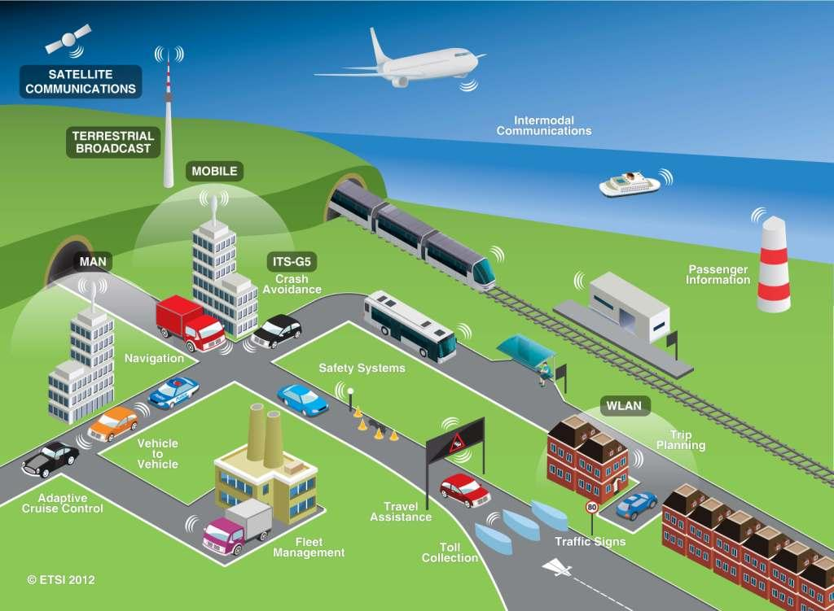
Intelligent Transport System (ITS)
Applying information and communication technologies to transport
3/24

Slide 4
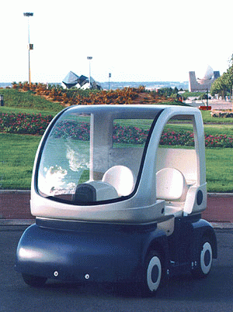
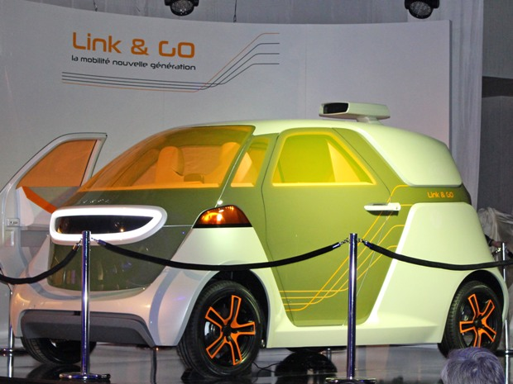
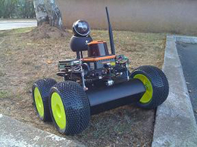
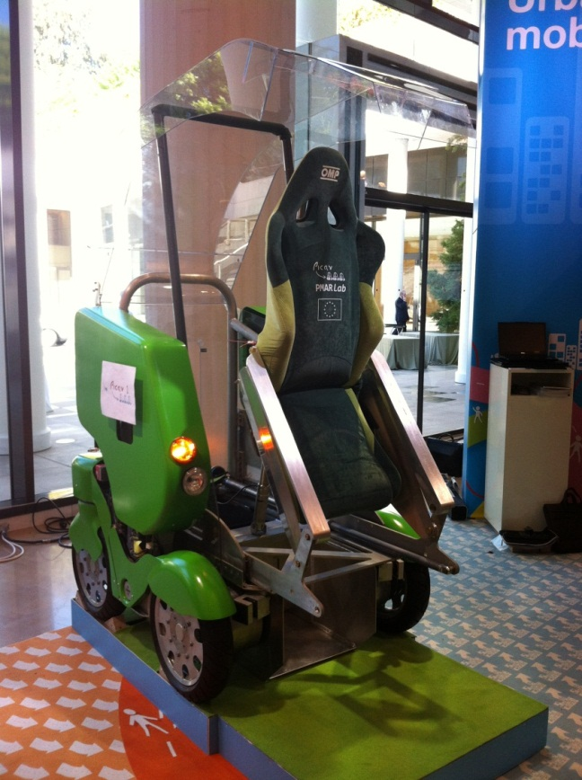
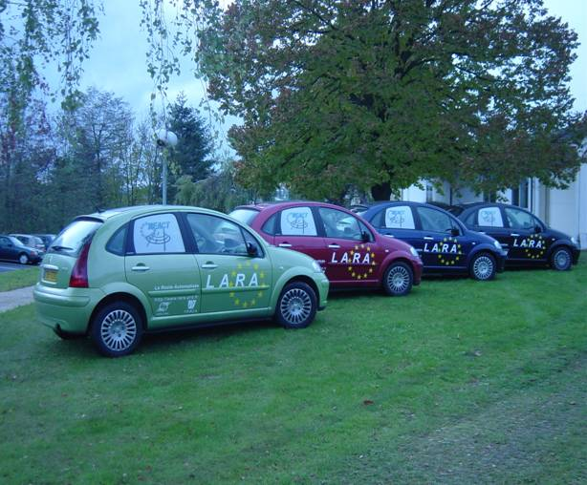
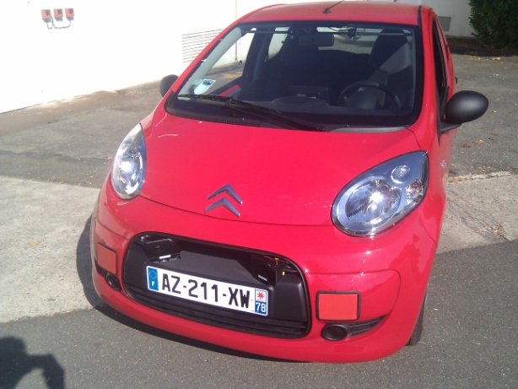
RITS: Robotics and Intelligent Transport System Ex-IMARA
Notes:
The team was created by Michel Parent in 1991. At the origin, that was not a research team but a “horizontal” team at INRIA. Its objective was the coordination and the transfert of all the research done at INRIA which can be applied to the the concepts of automated road and Cybercar. Cybercars are road vehicles with fully automated driving capabilities. A fleet of such vehicles forms a managed transportation system, for passengers or goods, on a network of roads with on-demand and door-to-door capability. This concept emerged in Europe in the early 1990's and was introduced for the first time in the Netherlands in December1997 for passenger transport at Schipol airport. Since then, it has been developped under a number of European projects such as CyberCars, CyberMove, EDICT, Netmobil and CyberC3

Slide 5
VeDeCoM institute (Véhicle Décarbonné et Communication)
Considering the whole mobility problem
Vehicle
Eco-mobility
Vehicle Electification
New practices, infrastructure and services
Shared mobility and energy
Zero emission in urban area
Demonstrations
Connectivity and delegated driving
Uncongested safe driving in urban area
Acceptability
Regulation
Convergence towards energy efficiency
New perspectives for personal mobility in urban and periurban areas compatible with low-carbon and renewable energy.
Notes:
IEED Institute created in 2012.
2 Programs : Vehicle and Eco-Mobility
3 Working groups : Vehicle electrification, Connectivity and delegated driving, Shared mobility and energy

Slide 6
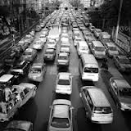
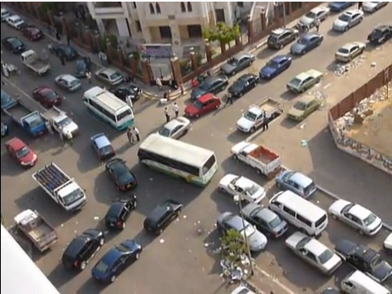
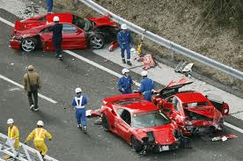
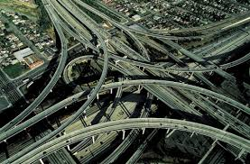
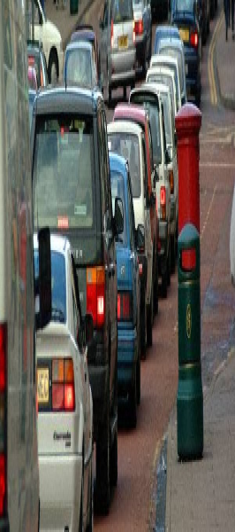
Notes:
The goal of Imara is to find new mobity solutions, in order to limit congestions, pollution, lake of space in the cities, blocked situations and in order to limit injuries by offering new mobility systems which are more safe and more reliable

Slide 7
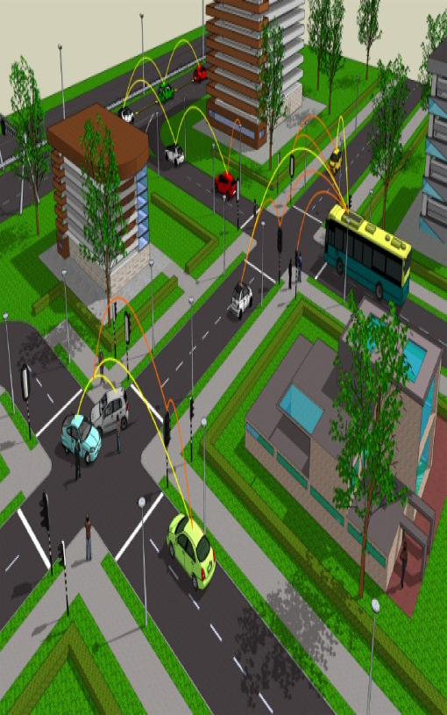
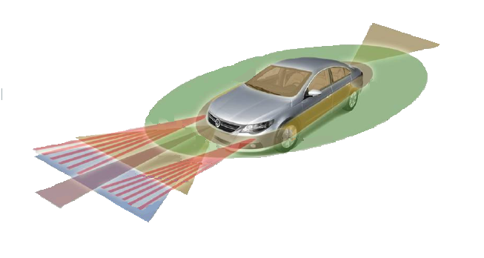

Slide 8
3 Main research topics
1
Robotics & ITS
Intelligent Transportation Systems
2
Modeling of large systems
3
Telecommunications & Networks

Slide 9
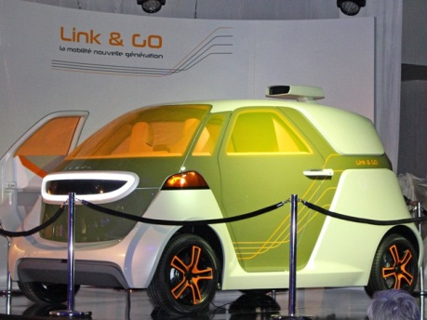
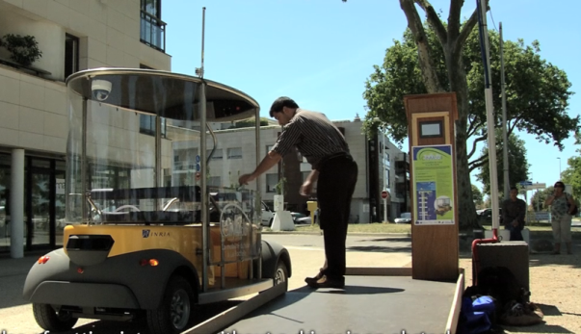
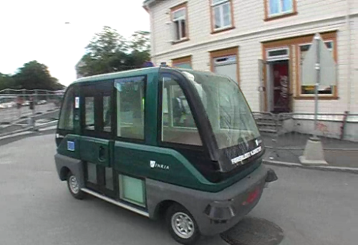
Generic Architecture for Automated Transportation Systems
2 canonical systems:
Automated vehicles
On-demand transportation system
Both use-cases have their specificities but,
Both use the same functional architecture with some variations
Both can share specific components (functions):
Perception: ego / geo-localization, obstacle detection,…
Planning: route planning, trajectories generation and control,…
Wireless communications
Notes:
SLAM Laser
SLAMMOT Stéréo
Manœuvre dépassement
Contrôle flou
Cooperative perception

Slide 10
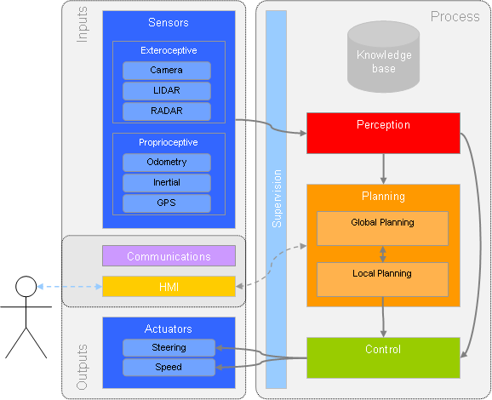
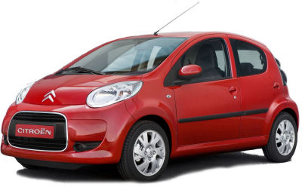
Generic architecture for autonomous driving

Slide 11
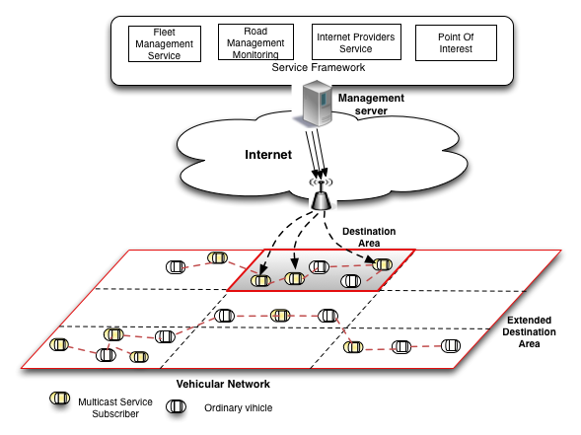
Vehicular communications
IEEE 802.11p standard
Wirelless Access in vehicular environment
Dedicated communication frequency
Considering mobility
Low latency

Slide 12
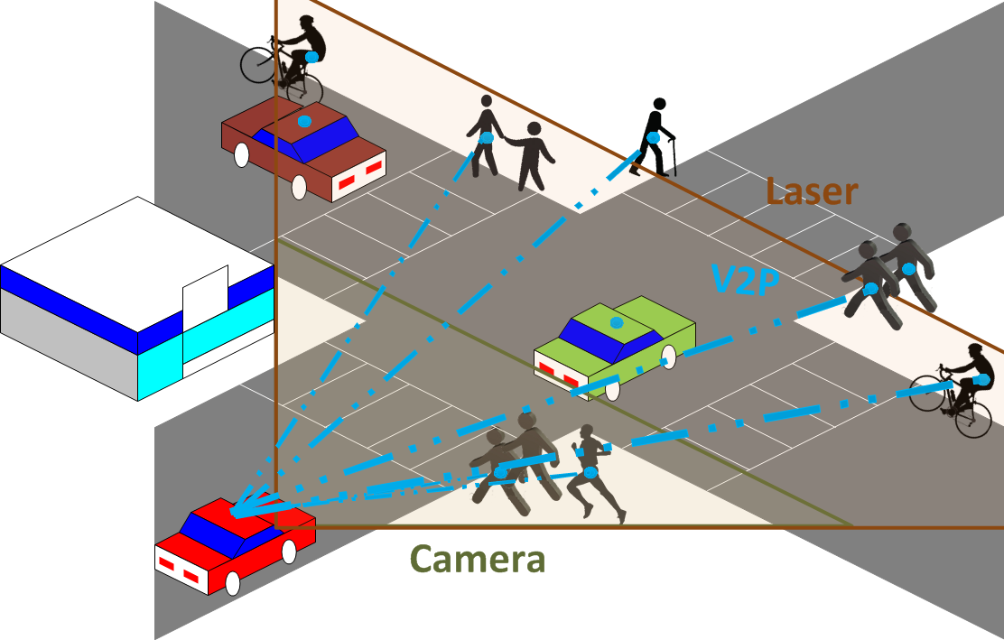
Vulnerable Road Users (VRU) safety
According to World Health Organization Report on Road safety 2013
More the 3000 people die daily due to dangerous driving
Half of all road traffic deaths are among pedestrians, cyclists and motorcyclists
Challenges of protecting pedestrians
Large variation in appearance
Dynamic and cluttered background
Highly irregular pedestrian motion
Problems of occlusion
Real-time processing required
High performance requirement (especially for emergency maneuvers)

Slide 13
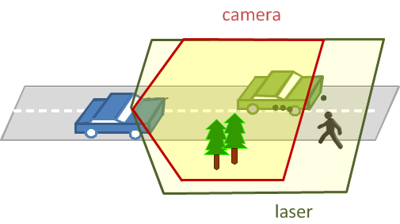
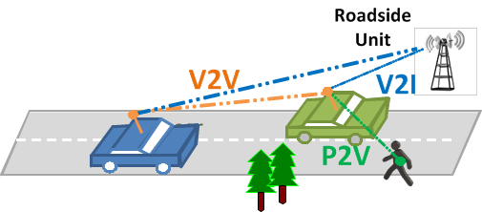
Development of a cooperative Perception and Communication System for Vulnerables Safety
Safety issues
Perception and communication
Situation assessment enhancement

Slide 14
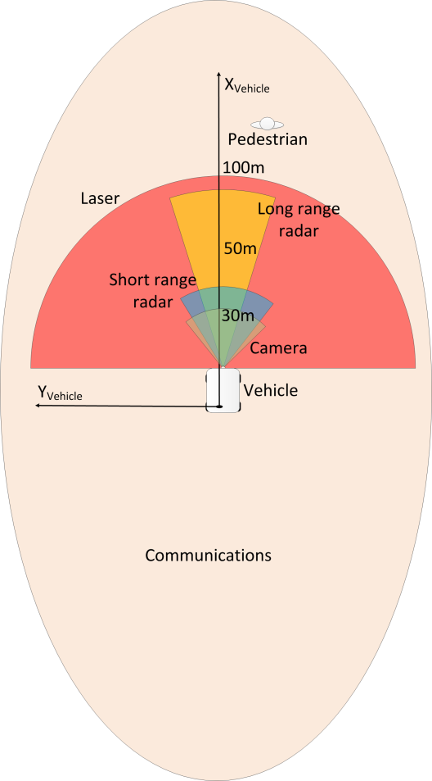
Perception of the environment
Localisation
Mapping
Detection
Classification
Tracking
Raw Laser Data
Video Data

Slide 15
Perception of the environment
Obstacle detection and classification
Definition of Region of Interest
Define region on the images (multicolor rectangles)
Projection of laser detection in camera image (red rectangles)
Segmentation and Clustering

Slide 16
Perception of the environment
Obstacle detection and classification
Recognition based on machine learning
HOG detectors
Cascade classifiers
Some false alarms
Segmentation and Clustering

Slide 17
Perception of the environment
Multi sensor fusion
Serial Fusion
Low Level Fusion
Parallel Fusion
High level fusion

Slide 18
Perception of the environment
Limitations of the perception
Use of V2P communications

Slide 19
Vehicle-To-Pedestrian (V2P) Communications
Different communication types
Vehicle-to-Vehicle (V2V)
Vehicle-to-Infrastructure (V2I)
Vehicle-to-Pedestrian (V2P)
Different communication media available
3/4G
Wi-Fi (IEEE 802.11b/g/n/p)
Satellite
Different architectures
Centralized communications
Distributed communications

Slide 20
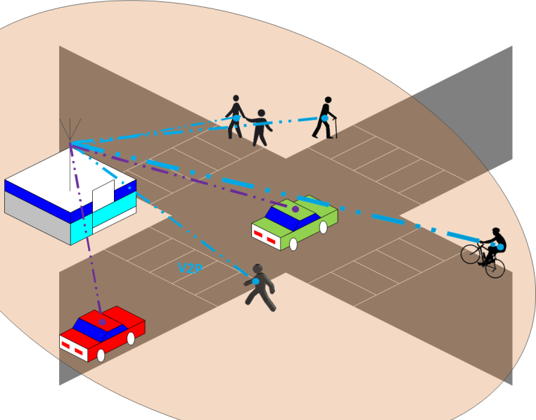
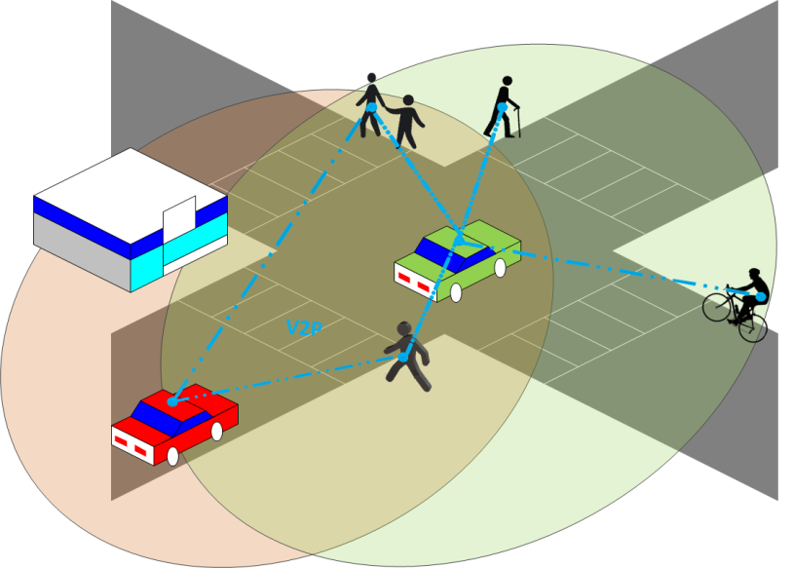
Vehicle-To-Pedestrian (V2P) Communications
Limited efforts on V2P
Pedestrians are equipped with smartphones
Bluetooth
Cellular Communications
Wi-Fi Communications
Constraints for the system
Reliability
Delay
Energy consumption
Primary Choice for Safety System
Distributed systems
Study of Wi-Fi systems

Slide 21
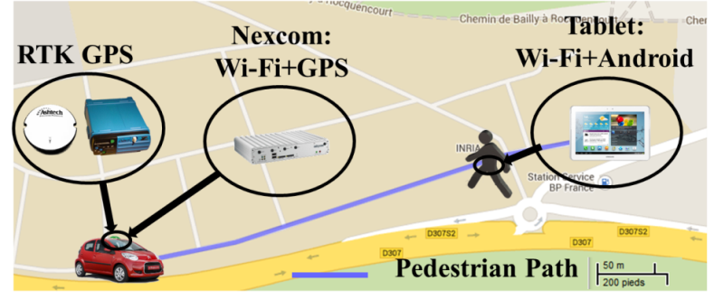
Vehicle-To-Pedestrian (V2P) Communications
A vehicle periodically broadcasts its dynamics to one pedestrian
Definition of requirements for VRU safety
Minimum distance before message should be received to avoid an accident : d_{min}
2 scenarios to test the signal blockage from human body
Pedestrian carries the tablet in his front close body
Pedestrians carries the tablet in his backpack
Measurements
GPS Accuracy
Packet Delivery Ratio
Packet Inter-Reception time
Notes:
Measurement based study

Slide 22
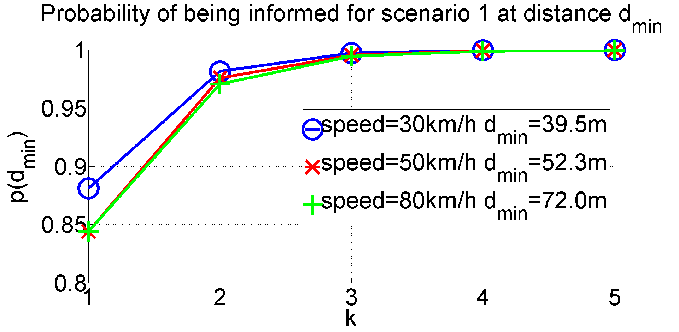
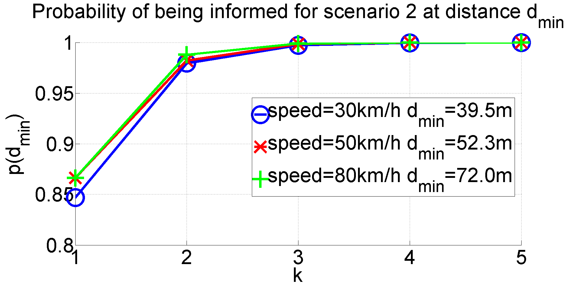
Vehicle-To-Pedestrian (V2P) Communications
Results
High positioning error (≈10m)
High communication range (≈400m)
Effects of human body not negligible (30% more loss at 400m)
Probability of correctly informing the pedestrian at distance d_{min}
$p\left(d_{min}\right)=1−\prod_{i=1}^{k}{\left(1−PDR\left(d_{i}\right)\right)}$
3-4 consecutives packets necessary
Blockage from human body
No blockage

Slide 23
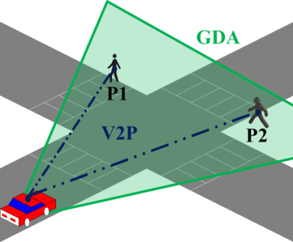
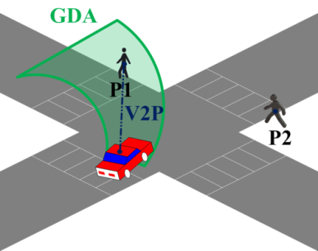
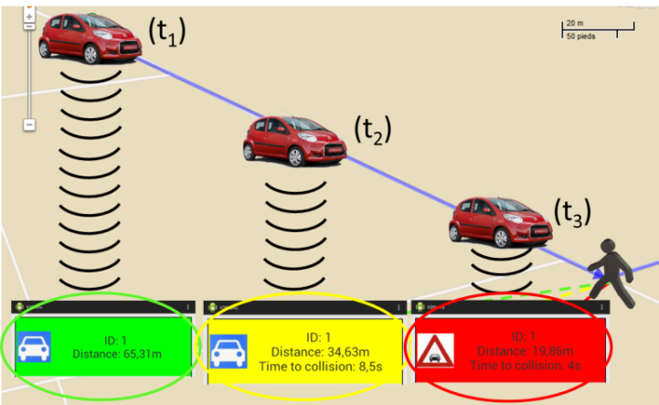
Vehicle-To-Pedestrian (V2P) Communications
Development of an Android application to alert pedestrians
Geographical destination area
Messages selected at the application level
Results
Safe (Green)
Warning (Yellow)
Danger (Red)

Slide 24
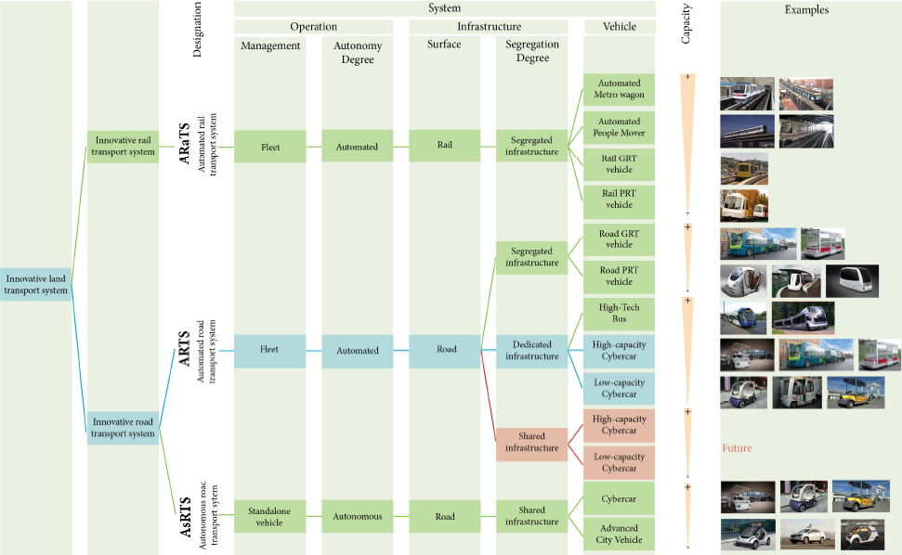
Conclusion
More experiment results on: https://team.inria.fr/imara/
Thank you for your attention!

