Slide 1
Investigation of the liver's adaptation to acute injury using multi-scale mathematical modeling
Géraldine Celliere
Notes:
First a few words about my group

Slide 2
MAMBA team
Modeling and Analysis for Medical and Biological Applications
Led by Marie Doumic-Jauffret
Joint with UPMC
At Inria, focuses on:
mathematical modeling of biological tissues (liver, tumors)
=> Mainly Dirk Drasdo
Protein aggregation in amyloid diseases
=> Mainly Marie Doumic-Jauffret
Notes:
First a few words about my group. Mamba is the name of a snake, but for us it means

Slide 3
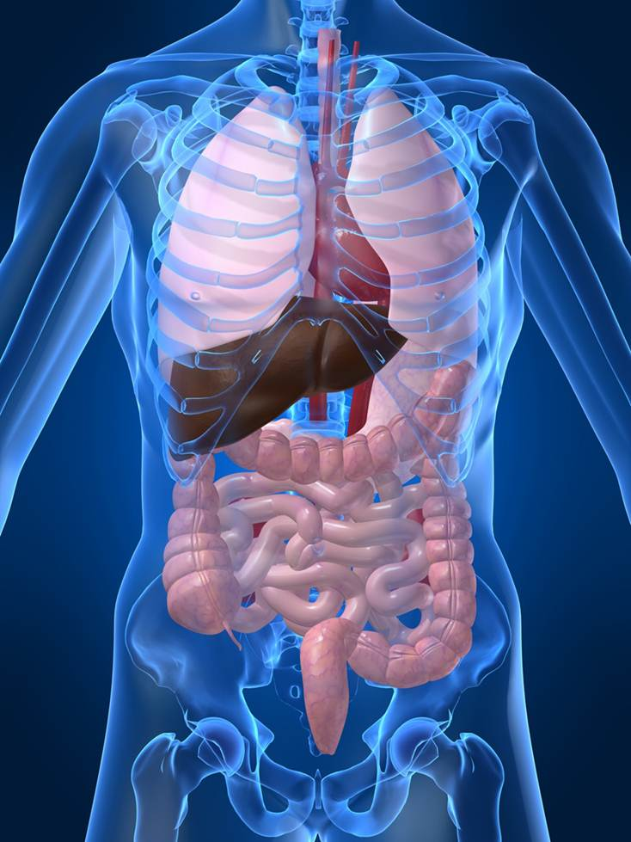
The liver has a number of key functions
Notes:
Although the liver is a very important organ, I am sure you don’t know its precise role and maybe not even where it is !

Slide 4
The liver has a number of key functions
Production of bile to help digestion
Carbohydrate, lipid and protein metabolism (storage or release of glucose, cholesterol, vitamins depending on the need)
Detoxification of toxins (pollutants) and drugs
Detoxification of ammonia (NH₄⁺)
Notes:
TEXT
The liver is a vital organ.
We are mainly interested in the two last functions.

Slide 5
The liver is also subjected to diseases
Infections such as Hepatitis
Cancer
Steatosis (accumulation of fat droplets)
Cirrhosis (accumulation of scar tissue, mainly due to alcoholism)
Drug damage (mainly due to paracetamol overdose)
Notes:
TEXT (foie gras)

Slide 6
The liver is also subjected to diseases but can regenerate
Infections such as Hepatitis
Cancer
Steatosis (accumulation of fat droplets)
Cirrhosis (accumulation of scar tissue, mainly due to alcoholism)
Drug damage (mainly due to paracetamol overdose)
Notes:
The good news is that the liver can regenerate ! If for example you have a tumor, you can cut a part of the liver and it will regrow.
Because the functions of the liver are so crucial, it is interesting to know how they are modified in case of disease. We are mainly interested in drug-damage. What is nice with drug-damage is that it happens quickly: in the mice 24h after the overdose, half of the liver cells are dead and after 8days, everything is back to normal.

Slide 7
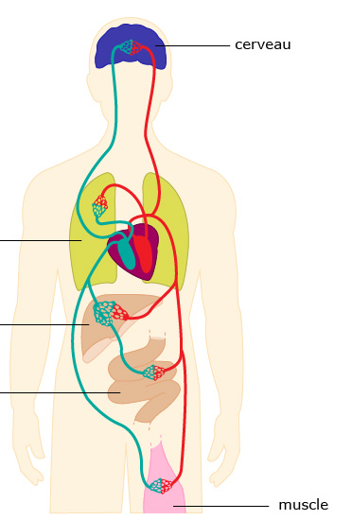
Ammonia is involved in life-threatening complications
NH4 enters the blood in the intestine. The blood continues to the liver, where ammonia is metabolized
In case of NH4 detoxification impairment, hepatic encephalopathy can occur
Current treatments of hyperammonemia perform poorly
The main cause of acute liver failure is paracetamol (acetaminophen) overdose
Notes:
Ammonia is interesting because it is involved in life-threatening complications of drug-induced liver damage and cirrhosis for example
The levels of ammonia in the body are tightly regulated and if the system is perturbed, it can have severe consequences.
After a meal, the bacteria in the gut produces ammonia from ingested proteins. This ammonia is enters the blood, and this blood flows first though the liver. Here the liver detoxifies ammonia, which means that it incorporates the NH4+ molecule into other harmless compounds. As a result at the liver outlet the ammonia concentrations are low. This blood then flows into other organs and in particular the brain.
If NH4 is not properly removed from the blood by the liver, high ammonia levels reach the brain and perturb the neurotransmitter system in the brain, leading to confusion or even coma. This trouble is called hepatic encephalopathy. And this happens frequently in case of drug-induced liver damage.
The current treatments of hyperammonemia perform poorly and sometimes a liver transplant is necessary.

Slide 8
Question
How is ammonia metabolism modified in the liver in case of acute damage ?
Integrated metabolic spatial-temporal model for the prediction of ammonia detoxification during liver damage and regeneration, Hepathology (2014) Schliess S., Hoehme S., Henkel S. G., Ghallab A., Driesch D., Böttger J., Guthke R., Pfaff M., Hengstler J. G., Gebhart R., Häussinger D., Drasdo D., Zellmer S.
Notes:
The mechanisms of ammonia detoxification are well known in the healthy liver. Are these mechanisms the same in the case of damaged liver ?

Slide 9
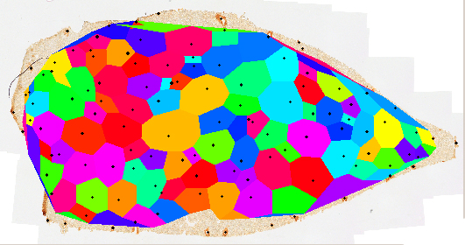
The liver has a complex architecture
Notes:
You answer this question, we first need to know about the liver architecture !
The liver is composed of a repetition of small functional units called lobules. A lobule has a hexagonal shape and is organized around a central vein. The blood arrives from the portal vein and flows towards the central vein in a network of small capillaries called sinusoids. These sinusoids are surrounded by hepatocytes that are in charge of detoxifying the blood.

Slide 10
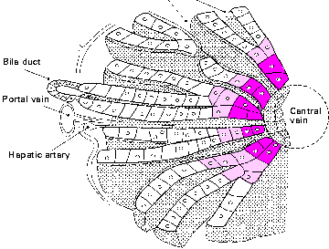
Zonation of metabolic functions
Ammonia detoxified through the urea cycle
- High capacity, low affinity
Ammonia detoxified through glutamine synthetase
- Low capacity, high affinity
No drug detoxification
Drug detoxification
Notes:
In addition the cells of the lobule are not all equivalent. The cells in the pericentral area express a different set of enzymes than the periportal hepatocytes.
Ammonia from the blood enters first the periportal hepatocytes where ammonia is detoxified though the urea cycle. This cycle has a high capacity but a low affinity, so that no all the ammonia is removed from the blood. The remaining ammonia is trapped in the pericentral cells by the glutamine synthetase enzyme that has a high affinity for ammonia.
The enzyme that detoxify the drug are also zonated. They are expressed from the central vein up to the middle of the lobule.

Slide 11
Mechanisms of paracetamol toxicity
Non-toxic compound
Secreted outside through the bile
Paracetamol/CCl₄
Notes:
When amount of paracetamol or carbon tetrachloride (which does the same type of damage) are low, it is safely metabolized to a non-toxic compound that will be secreted out of the body.

Slide 12
Mechanisms of paracetamol toxicity
Non-toxic compound
Secreted outside through the bile
Saturation
Paracetamol/CCl₄
Toxic compound
Cell death
Cell death
Notes:
But if there is too much paracetamol, the first detoxification pathways gets saturated and a second one takes over but it produces a toxic compound that kills the cells. And it kills only the cells that express the detoxification enzymes so only the cells in the center of the lobule are killed.
Ok now you have all the required knowledge and we can start with our question: when the liver is damaged, how is ammonia detoxification altered ? And to answer this question, we use mathematical modeling.

Slide 13
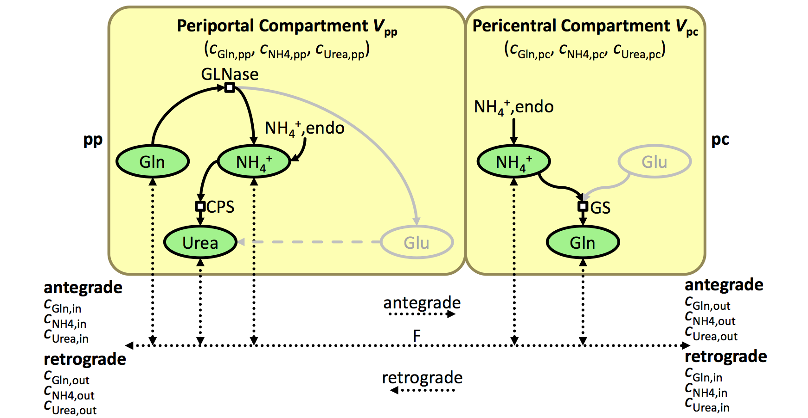
What is mathematical modeling?
Liver
Blood influx
[metabolites]
Blood efflux
[metabolites]
V(t)
compare
Blood influx
[metabolites]
Blood efflux
[metabolites]
V(t)
Notes:
What is modeling about ?
From an experimental point of view, the liver is a black box.
The influx and efflux of the liver has been measured over time after drug-induced liver damage. We know what happens but we don’t know why. The goal is to understand what happens in this black box by using a mathematical model. The entering metabolites concentrations and the volumes of healthy and damaged zones are used as input, the metabolites at the outlet are simulated and compared to the data.

Slide 14
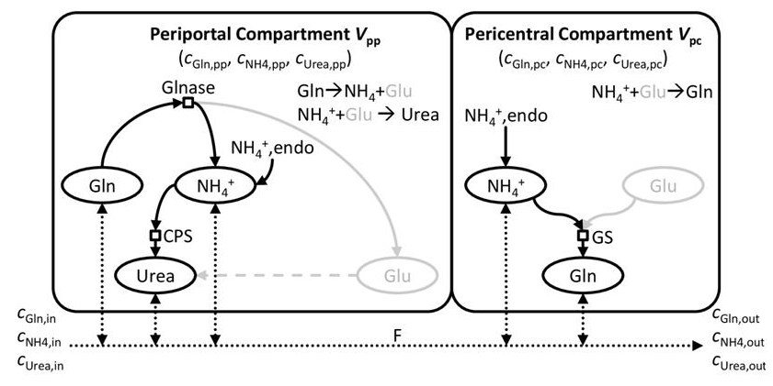
Step 1: build a model of NH4 detoxification
Notes:
In a first step, we build a model of what we know happens in a healhty liver.
In the liver ammonia is detoxified by two processes occuring in two different areas (here and here). We represent the two areas by two compartments in the model and the key reactions involved in the process are translated into a set of ordinary differential equations, that look like that.
We represent only the key metabolites of the classical detoxification scheme. In total we have 6 ordinary equations: 3 metabolites times 2 compartments. In this system we have parameters which value is not well known. For exemple the speed of these equations. So the first step is too find values for these parameters. To do so we fit the model to experimental data.

Slide 15
Step 2: Calibration of the metabolic model with data of healthy livers
Good agreement
Notes:
To calibrate the parameters appearing in the equation, the model was fitted on ex-vivo data.
The data that we have is the concentration of the key metabolites at the outlet of a perfused ex-vivo liver have been measured in several conditions. So we run simulations representing exactly this setting and changes the parameters unilt the best agreement with the data was obtained. (optimization problem)
This is the agreement we get with the estimated parameters.

Slide 16
Step 3: Simulate the classical scheme in case of liver damage
Will we be able to reproduce the measured metabolites concentrations in the case of a damage if we assume that the reaction are the same but part of the liver is destroyed (changed volumes) ?
Notes:
Now the question is: if we assume that the reactions happening in the damaged liver are the same and that only the volumes of the healthy and damaged part changes, will the model output the same concentrations as experimentally measured ?
To do this, the equation is the same except that the volume is now time dependent. This volume we know it from experiments.

Slide 17
Step 3: Simulate the classical scheme in case of liver damage
Notes:
This is the result … On the x axis we have time: the healthy situation , at day 2 a very high damage and then lower and lower damage due to the regeneration and at day 12 back to the control situation. In blue we have the concentration at the liver inflow, that we take as model input. In red the measured output concentration and in orange the simulated one. For glutamine, the model performs quite good, but for ammonia, the predicted concentration is too high at all time of liver damage.

Slide 18
Step 3: Simulate the classical scheme in case of liver damage
There is something missing in the model …
Notes:
There is something missing in the model …

Slide 19
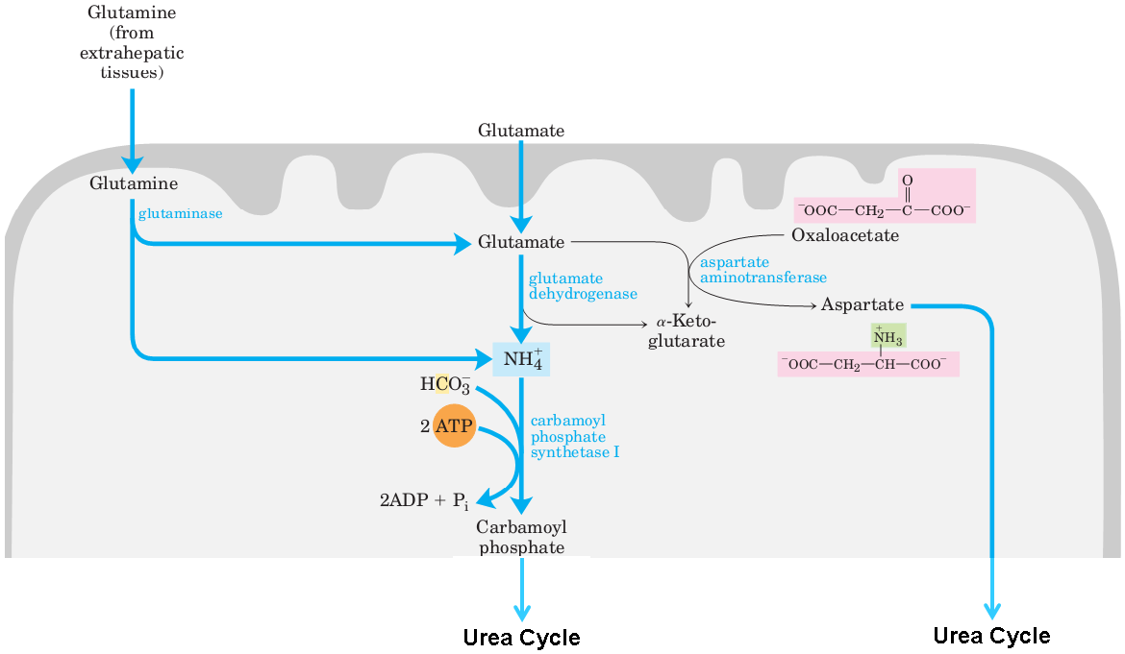
Step 4: Asking the experimentalists
Notes:
They told us: well there is the glutamate dehydrogenase reaction. Usually it is ammonia producing, but the reaction is reversible so in principle it could also be ammonia consuming depending on the concentrations of the reactants and products …

Slide 20
Step 4: Asking the experimentalists
GDH
+
+
Glutamate
NADP⁺
NH₄
+
α-KG
+
NADPH
Notes:
This is the total reaction.
According to thermodynamic considerations, if there is a lot of NH4, aKG, and NADPH the reaction will go in this direction, etc …

Slide 21
Step 5: Adding the GDH reaction to the model
Cellular Periportal
Glu
Cellular Pericentral
endo
endo
Gln
GLNase
GDH
Glu
aKG
NH4
aKG
GDH
NH4
GS
CPS
Gln
Urea
Will the new model be able to reproduce both the data from the healthy case and from the drug-induced damage case ?
What will be the direction of GDH over time in the damaged case ?
Notes:
Ok, so let’s add the GDH reaction to the model.

Slide 22
Step 5: Adding the GDH reaction to the model – Open questions
Cellular Periportal
Glu
Cellular Pericentral
endo
endo
Gln
GLNase
GDH
Glu
aKG
NH4
aKG
GDH
NH4
GS
CPS
Gln
Urea
How to deal with “boundary conditions” ?
When is a match between model and data good enough ?
Notes:
This is ongoing work and I am still faced with difficulties …
The first one is what to do with the boundary conditions. Here I have depicted the main reactions, but there are other reactions producing and consuming glutamate for example. How should these reactions be modeled ? With a constant term, but then we assume that the net balance of the neglected reactions is the same over time, which is maybe not true …
And the second one is when should we step adding new features to the model. When do we decide that the model is reproducing the data sufficiently well ?
These two difficulties tend to push us towards bigger and bigger models … When you have a model model, you usually have more unknown parameters that give more freedom to your model, but in my case, because a lot of compounds have been measured, if you add one more metabolite to the model, it is also one more metabolite that need to match with the measurements. So both the number of parameters and the constraints are increased so that it is not necessarily easier.

Slide 23
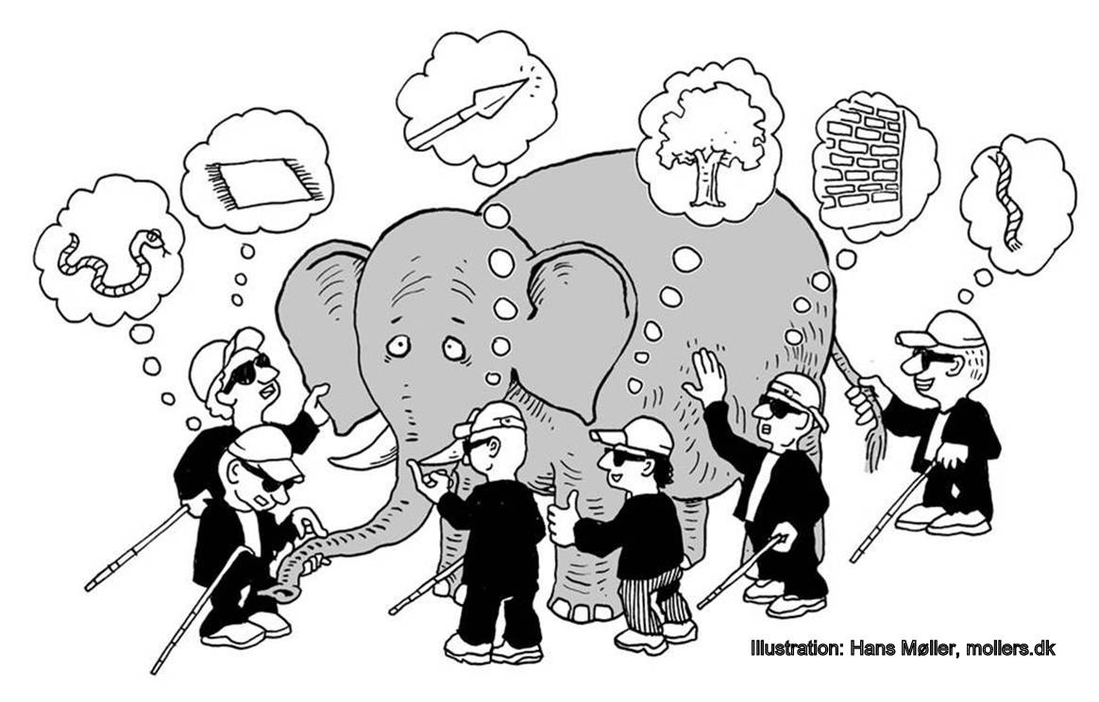
Why is modeling useful?
Putting together a coherent picture of an entire system – organizing the knowledge
Notes:
One of the role of modeling is to synthetize the current knowledge into one common model and see if everything make sense. The experimentalists are a bit like blind men touching an elephant: each focuses only a small part of the system, without having a global view. The the task of the modelers is to build a more global picture using the knowledge of each experimentalists. Doing so we can infer organizing principles at a larger scale.

Slide 24
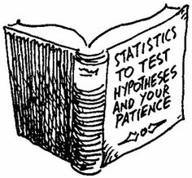
Why is modeling useful?
Testing the plausibility of hypotheses
How does the liver regenerate ?
Cells proliferate
Cells proliferate + migrate towards center
Cells proliferate + migrate towards center + cell division is aligned along the blood vessels
With modeling we could show that hypotheses a) and b) are not possible.
Notes:
Modeling is also useful to test the plausibility of hypotheses. Another member of our group for example worked on the regeneration of the liver after the damage. After discussions with the expeimentalists he tested several hypotheses about the mechanisms at play during the regeneration and the closure of the dead cell area. Maybe the celsl are just proliferating and the new mass closes the gap. Or maybe they proliferate, but also migrate towards the center of the lobule. Or maybe they proliferate, migrate and also when they divide, the direction of the division axis is not random but aligned in the same direction as the blood vessels. Through modeling, we could show that hypotheses a and b are not possible. We do not manage to reproduce the right closure times.

Slide 25
Why is modeling useful?
Guiding new experiments
Notes:
Once we have identified which are the possible and not possible hypotheses, we can guide the experimentalists towards the most informative experiments to do …

Slide 26
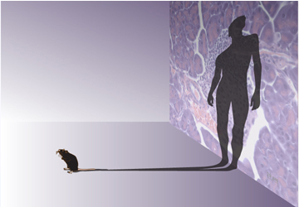
Why is modeling useful?
Explore situations that are unreachable or too costly for experiments
Extrapolation from animal to human and from in vitro to in vivo
Notes:
At some point, you want to be able to say something about humans, not only mice. But giving a paracetamol overdose to a human just to measure its ammonia levels is not allowed. In that case modeling can help to bridge the gap between animals and humans or between in vitro and in vivo.

Slide 27
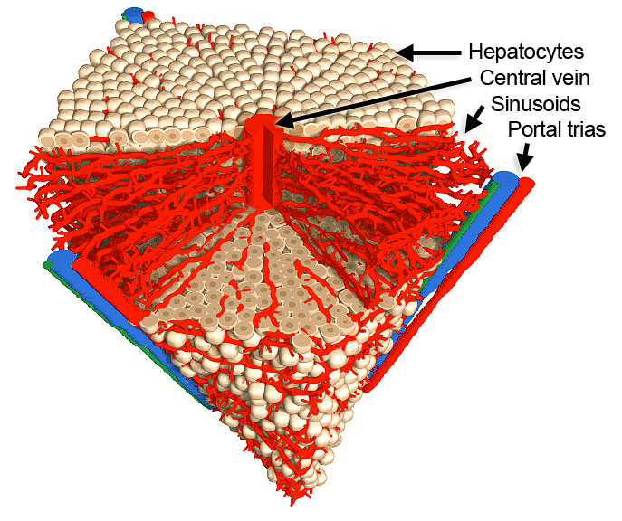
Conclusion
The classical ammonia detoxification scheme cannot explain the observations during liver damage
GDH might be an important enzyme in this process
Modeling can really help in biology
Perspective: investigate the influence of the spatial geometry by replacing the compartment model by a spatially resolved model

Slide 28
Acknowledgement
Dirk Drasdo Group:
Stefan Hoehme
Tim Johann
Adrian Friebel
Johannes Neitsch
Paul van Liedekerke
Yi Yin
Noemie Boissier
Margriet Palm
Francois Bertaux
Jan Hengstler Group:
Marc Brulport
Alexander Bauer
Ahmed Ghallab
Sebastian Zellmer
Dieter Häussinger
Rolf Gebhardt
Michael Pfaff
Reinhard Guthke
Jan Böttger
Dominik Driesch Sebastian Henkel
Freimut Schliess
Geraldine Cellière
(geraldine.celliere@inria.fr)

