Slide 1
Autonomous Quantum Error Correction
Joachim Cohen
QUANTIC

Slide 2
Outline
Why quantum information processing ?
Classical bits vs. Quantum bits
Quantum Error Correction

Slide 3
Why quantum information processing ?

Slide 4
Why quantum information processing ?
Cryptography : quantum key distribution
Quantum simulator : simulation of quantum systems
Quantum algorithms : Shor’s algorithm on prime number factorization in polynomial time

Slide 5
Classical bits vs. quantum bits

Slide 6
Classical Bit : Bistable system
Bit : State 0 ou 1
Courtesy of Michel Devoret, Collège de France, 2010

Slide 7
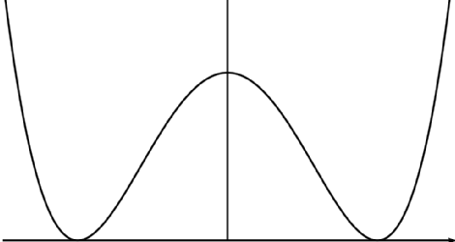
Classical Bit : Bistable system
0
U(x)
1
ΔU
noise k_{B}T
x
: friction coefficient
friction
thermal noise k_{B}T<<ΔU

Slide 8
Quantum physics ?
Quantum bit (Qubit) ?

Slide 9
Spring : Classical case
k
x
m
E
Harmonic potential
Large A²
No dissipation :
constant energy
Small A²
x

Slide 10



Quantum Mechanics : System energy is quantified !
Example : Light
photon
photon
photon
FINISH
1, 2, 3, … , N, … !
Energy = N*hω !
Light energy is quantified !
photodetector

Slide 11
Spring : Quantum case
Discrete set of stationnary energy states :
ψ₀(x), ψ₁(x), ψ₂(x), ψ₃(x) ...
L² functions associated to energies E₀, E₁, E₂, E₃ ...
lψ(x)l² = density of probability to find the system in x
Restrict to the first two energy levels :
satisfying
E
and
3
ħω
ψ₁(x)
2
1
ψ₀(x)
ħω/2
0
x
x

Slide 12
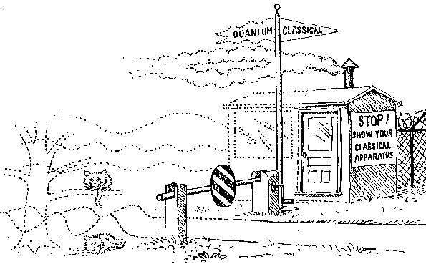
Postulate 1 : Quantum superposition
form an orthonormal basis of a 2D-Hilbert space with
Quantum superposition : general state is given by
- probability to find the system in state
Qubit!
- probability to find the system in state
…

Slide 13
Postulate 2 : Quantum Measurement
Quantum measurement :
  Consider the qubit in state
  Ask the system : are you in or ?
  With probability the answer is
  The system is projected in state !
  Measurement modifies the qubit state !
  Quantum measurement can be DESTRUCTIVE !

Slide 14
Composite system and Quantum Entanglement
Composite system : Consider two qubits A and B
  Qubit A lives in
  Qubit B lives in
  Joint system qubits A+B lives in
Entangled state :
  Consider
  First, we measure qubit A : we find qubit A in
  (with 50% probability )
  The joint state collapses to
  qubit B is in with probability 1 !
A
B
…

Slide 15
Quantum « rules » : Summary
1) Quantum superposition : general qubit state
2) Measurement : revealing information about the state can destroy the superposition
3) Quantum Entanglement : possibility of having strongly correlated states between two qubits

Slide 16
Consequence : Decoherence
Unwanted coupling with the environment :
Qubit
Environment
-The environment measures the qubit
and this measurement destroys the quantum superposition !
-> lifetime of typically 100us (for superconducting circuits)
- Lifetime decreases with the number of qubits
How can we fight decoherence ?

Slide 17
Quantum error correction (QEC)

Slide 18
Bit vs. Qubit errors
Errors on classical bits : bit-flip errors 0 1
1 0
Errors on qubits :
  Bit-flip errors Phase-flip errors
Errors can be cast in two error channels :
-
Rest of the talk

Slide 19
Quantum error correction
Classical error correction:
information redundantly encoded
Ex : 0 000
1 111
such that error on bit 1 : 100 000
error on bit 2 : 101 111

Slide 20
Quantum error correction
Quantum error correction (bit-flip errors only)
three-qubit bit-flip code :
Error on qubit 1 :
encoding
=
=
correction
But information about and
must not be revealed ...
How do we detect errors
without destroying the state ?

Slide 21

Quantum error correction
Error detection : Parity measurement
qubit 1 flips
P₁₂ = 0 P₂₃ = 0
qubit 2 flips
P₁₂ = 1 P₂₃ = 0
Do not measure :
Single parities
P₁, P₂, P₃
qubit 3 flips
P₁₂ = 1 P₂₃ = 1
What we can measure :
Joint parities
P₁₂ := [Q1+Q2] mod 2
P₂₃ := [Q2+Q3] mod 2
P₁₂ = 0 P₂₃ = 1
NON-destructive measurements !

Slide 22
Quantum error correction
Error Correction : simply apply inverse operation
flip qubit 1
P₁₂ = 1 P₂₃ = 0
flip qubit 2
P₁₂ = 0 P₂₃ = 0
flip qubit 3
P₁₂ = 1 P₂₃ = 1
P₁₂ = 0 P₂₃ = 1

Slide 23
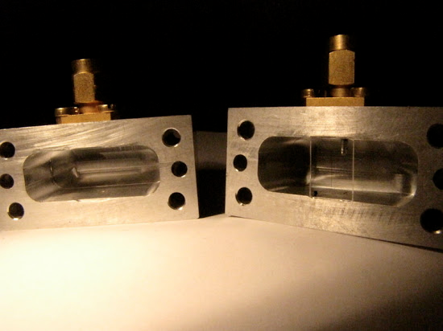
Quantum error correction : implementation
1st option
Build a feedback loop
  real-time data analysis takes time
  quantum systems are short-lived
Superconducting circuits
100 us
Courtesy of Quantum Electronics group, LPA, ENS (Paris)

Slide 24
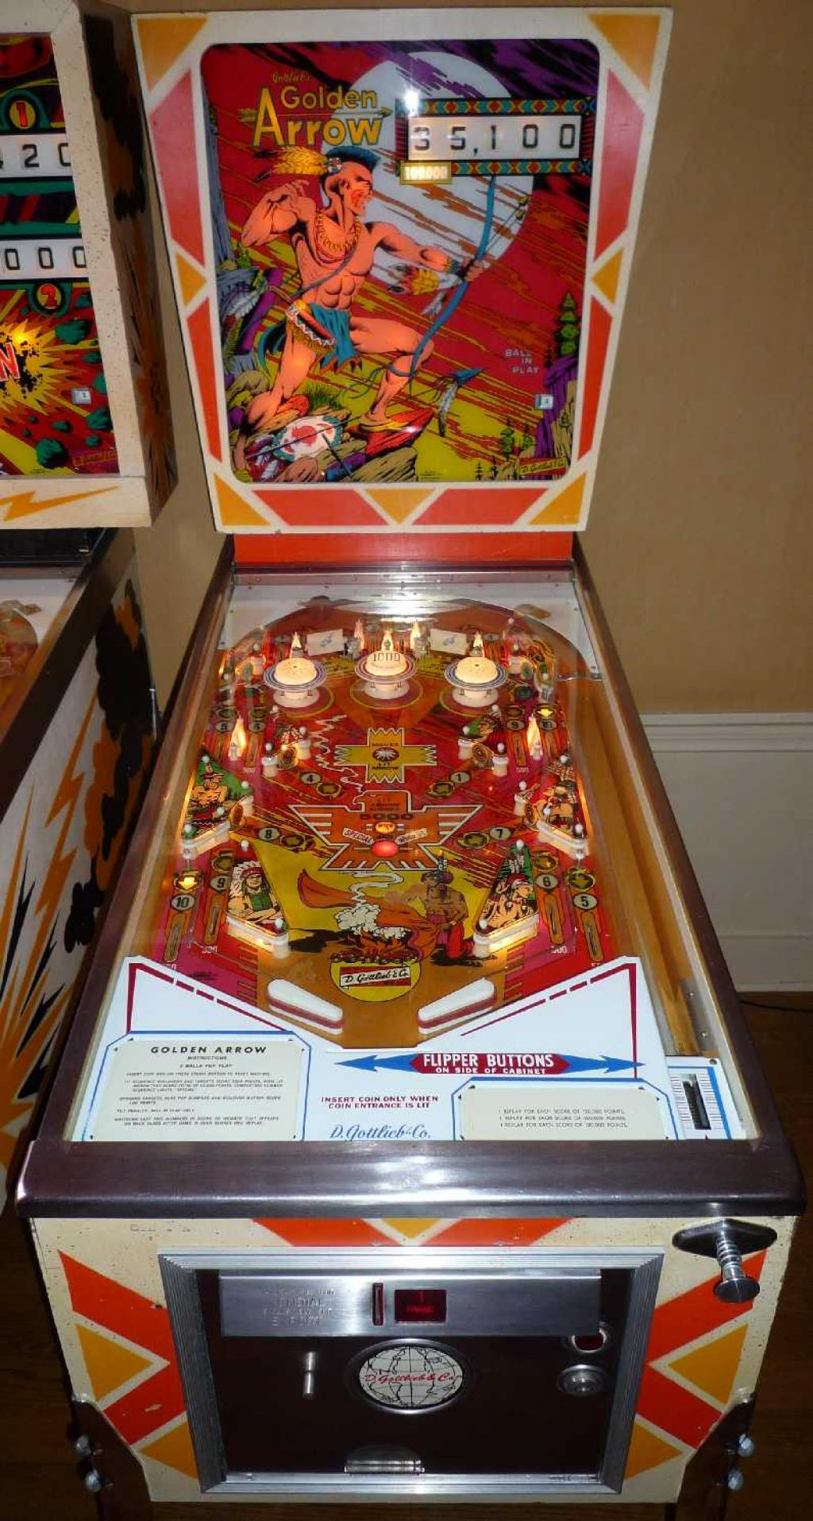

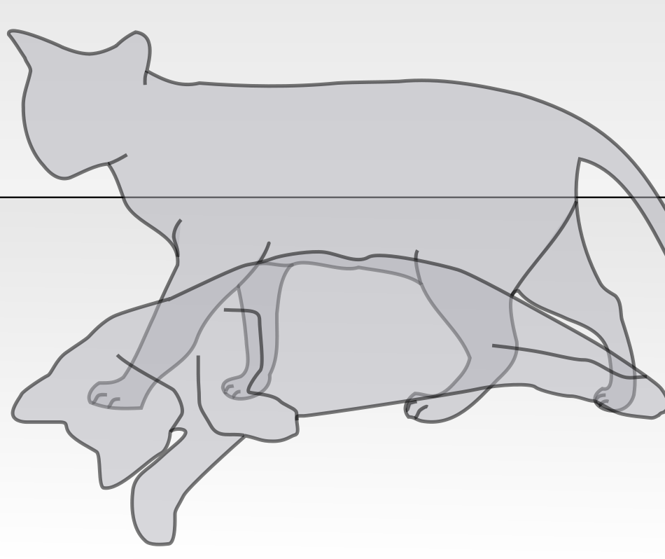
Quantum error correction : feedback loop
Error Correction ? Use a flipper !
Measurement output
Error syndrome
qubits system
P₁₂ = 0,1
P₂₃ = 0,1
feedback

Slide 25
Quantum error correction : implementation
2nd option : (what we have proposed)
Autonomous QEC by coupling the qubits with another strongly dissipative quantum system :
Dissipative
system
Qubit
designed
coupling

Slide 26

Autonomous quantum error correction
Main idea :
Coherent stabilization of the manifold {l000>,l111>} through dissipation
coupled system
does not distinguish
x
+

Slide 27
In practice
Complete codes (correct for all types of errors) exist but have never been physically implemented
Qubits of many kinds : trapped ions, superconducting qubits, NV centers ...
Quantum computer : 10 qubits max so far. Limited by decoherence !
-> QEC remains a challenge to overcome !

Slide 28
Thanks !
Questions ?

